Slide 1


Meet the Teacher – Year 2
Wednesday 9th September

Slide 2

Vision and Values
We expect EVERYONE (including parents) to live them!
Nurturing potential for all within a Christian ethos
Together we will work to enable all our children to achieve their full potential within our Christian family.
We nurture individuality - providing challenge, developing self-esteem and promoting care and respect for each other and God’s world.
Therefore encourage one another and build each other up – 1 Thessolanians ch 5 v 11
As a Church school we have a distinctive character where Christian values are promoted in all aspects of school life.

Slide 3
Introducing the team
Miss Beynon
Mrs Mayman
Mrs Madelin
Mrs Rae – Friday afternoon

Slide 4
Settling in
Establishing routines
Understanding expectations
Reminders of rules
Revision of Y1 spellings

Slide 5
Timetabling
PE days – Wednesday and Friday: children should come to school in PE kit on these days
Topics covered this year include:
The UK, Africa and The coast in Geography
The Great fire of London, Lives of Significant Individuals and Grace Darling in History
The class pages and school website will have further information about the curriculum – e.g for Knowledge Organisers

Slide 6
How is Year 2 different to Year 1?
Children will continue to build up reading fluency and read longer books. When appropriate short chapter books.
Number knowledge will extend to numbers up to 100.
They will begin to learn times table facts x2, x5, x10 later in Year 2
Learn more joins for joined up handwriting when appropriate
Write longer pieces and use additional punctuation (commas in list, apostrophes for possession and contraction)

Slide 7





Curriculum
In the mornings the children will have the following subjects
SPaG (spellings, punctuation and grammar)
Reading fluency
English and maths.
In the afternoon we begin with reading, either in groups, individual readers or reading for pleasure.
The rest of the afternoon will focus on the following curriculum subjects:
History/ Geography, Computing, Science, PE, Jigsaw (PSHE), Music, Art/ DT and RE.

Slide 8


Expectations
Respectful behaviour, including respect for belongings
Being ready for learning
Keeping themselves and others safe
Please help your child practise drawing lines and underlining with a ruler.

Slide 9

The importance of reading
The children will continue to work through Little Wandle books according to the level that is appropriate for them.
The children will then move over to coloured bands (Purple, Gold, White, Lime and/ or Little Wandle Fluency books ).
Please record and sign your child’s reading record whenever they read to you.

Slide 10


Slide 11
Rewards
Children will continue to earn house points for exceptional work and behaviour as well as showing the school values.
We are aiming for children to do well - because they want to, not for a reward....

Slide 12
How you can help at home
Homework for Year 2 will be daily reading and times table practice
(towards the end of Year 2) as well as number bonds.
Research has proved that children that are supported regularly with these aspects of learning feel more confident and secure with accessing learning in the classroom.
Other ways to support your child include engaging with the knowledge organisers (these have key questions and vocabulary related to each topic)
Spellings will also be sent home once a week, and the children will be informally tested on these the following week. Children learn spellings in different ways - daily, look, cover, write check, works for some; saying them out loud; writing in different coloured pens; sometimes we will send you a link to a spelling game on the computer.

Slide 13

St. John’s passport
This is an A5 booklet with a cardboard front cover. Similar in size and style to the KS2 reading record books

Slide 14
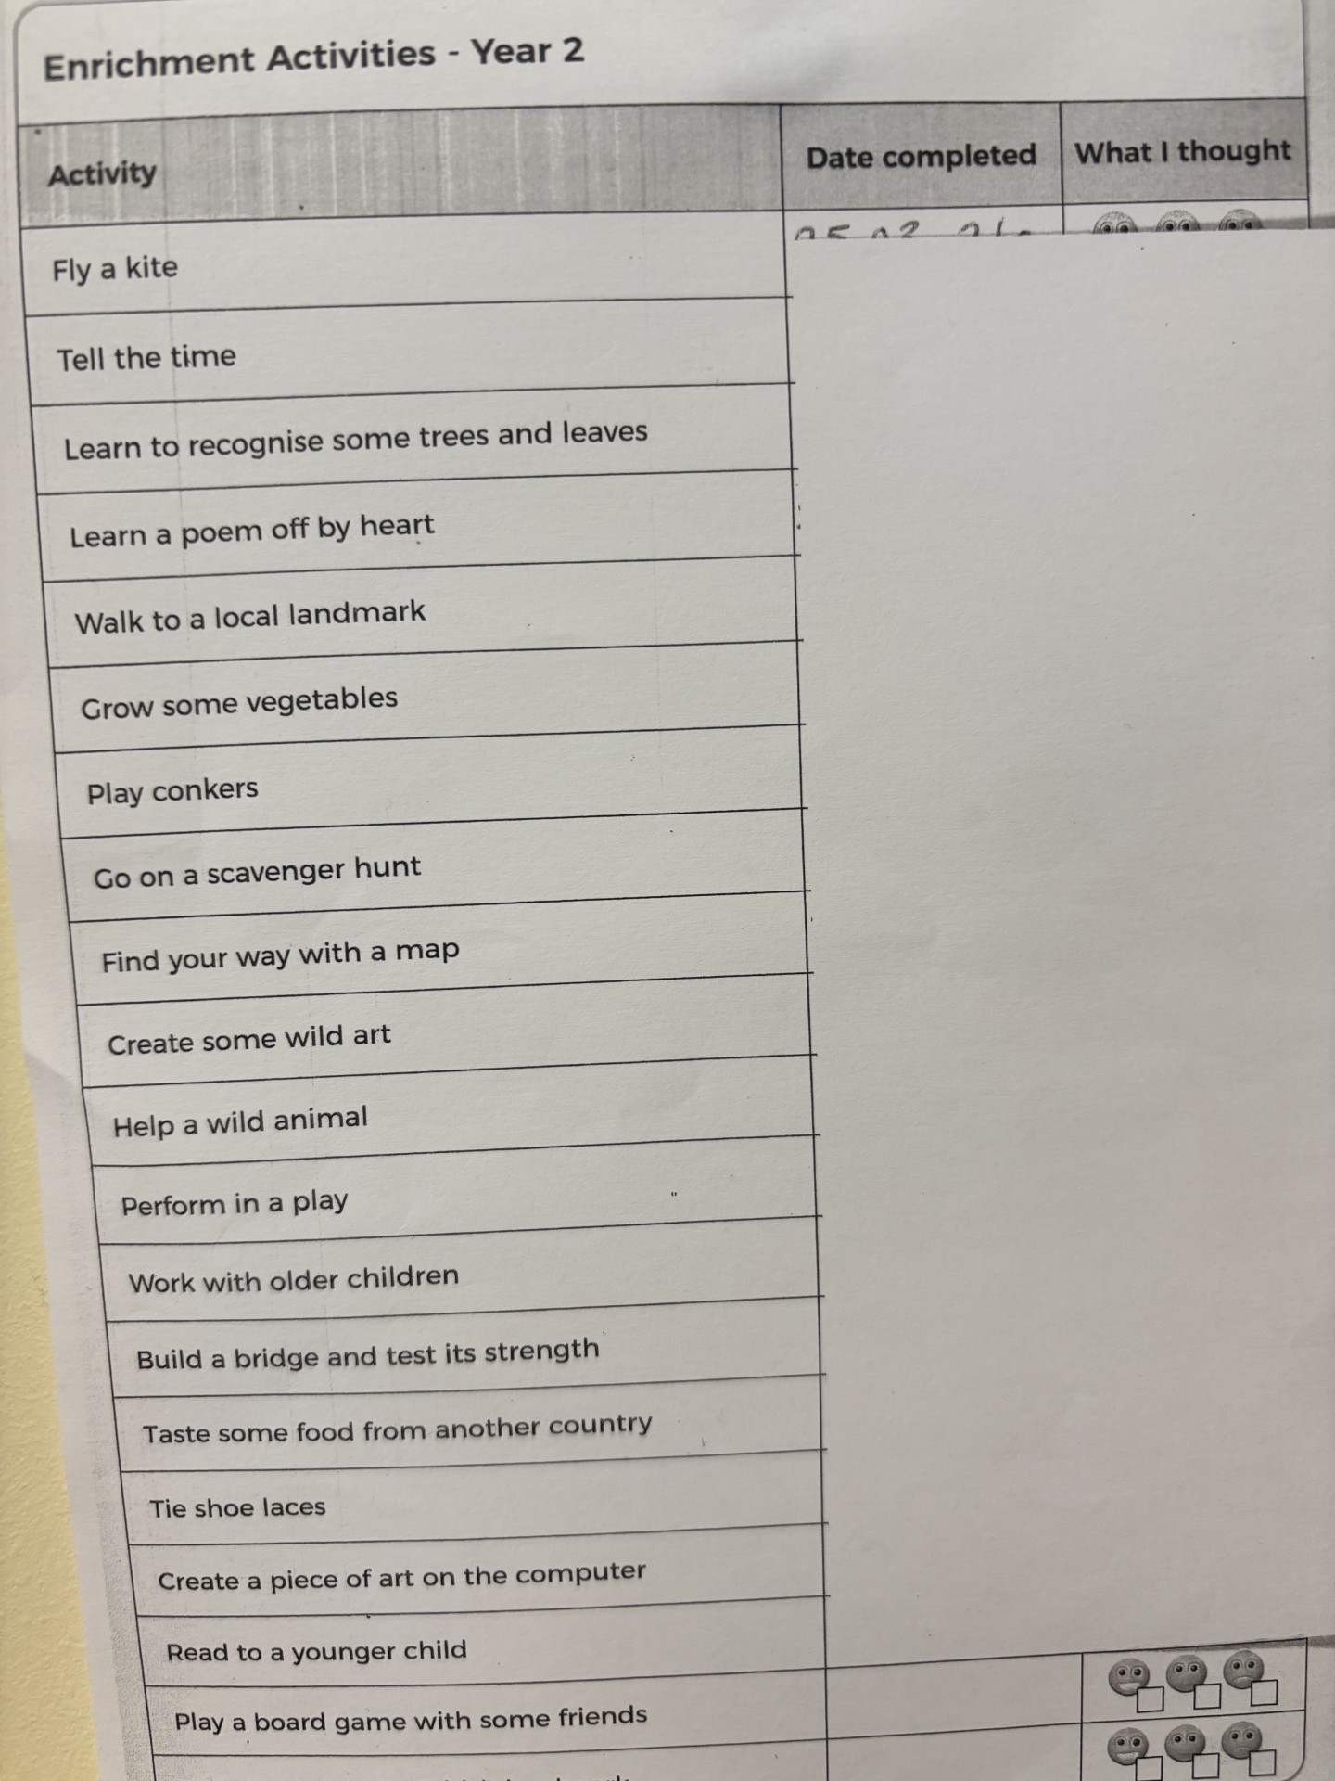

Slide 15
Pick up and drop off information
Gates open from 8:30am
Pupils enter school 8:40am (KS1 entrance – opposite Y2 classroom)
Register closes at 8:50am
Gates open at 3:00pm
Pupils let out at 3:15pm

Slide 16
Drop in sessions
For any questions, catch ups
Monday 3.30 - 4pm
Starting Monday 21st September
Please make an appointment if you need a longer, more in depth conversation
Parents Evening will be before half term

Slide 17
Contact information
Email office who will forward to class teachers
Please be aware that we do not answer during the day as we are teaching
Friday News has all the information about what we have been learning during the week
If it is urgent phone the office 01844 343521

