Slide 1


Year 1 Meet the Teacher
Thursday 10th September 2026

Slide 2

Introduction/Staff
Miss Fogg – Monday to Friday
PPA – Wednesday afternoon – Mrs Harrison covers
TA’s – Mrs Haycock and Mrs Honeyben (mornings) and Miss Barnes (afternoons)

Slide 3
Vision and Values
We start the year reminding everyone of our vision and values. As a Church school we have a distinctive character where Christian values are promoted in all aspects of school life.
Nurturing potential for all within a Christian ethos
Together we will work to enable all our children to achieve their full potential within our Christian family. Through the teachings and examples of Jesus, we nurture individuality - providing challenge, developing self-esteem and promoting care and respect for each other and God’s world.
‘Therefore, encourage one another and build each other up’
1Thessalonians 5:11

Slide 4
Timetabling
Please see the Year 1 timetable on the next slide, this might change.
Year 1 is a mix of structured learning and continuous provision.
We know the jump from Reception to Year 1 is a big step for the children, however we work with them to make this transition as smooth as possible and ensure they settle in well.

Slide 5

Timetable

Slide 6
Topics
6 key topics covered (1 per half term):
Paddington
Toys through time
Hot and Cold places
Captain Scott
Recycling
Moon Landing
Look on the class pages for Knowledge Organisers and further information

Slide 7
PE
Our PE lessons will be on the following days:
Tuesday morning
Friday morning (with Coach)
Children should come into school wearing their PE Kits.
Please name everything – especially jumpers and cardigans.
Children should wear a St John’s polo shirt, black or navy shorts and plimsolls or trainers for PE. When the weather is cooler, they can wear black/navy joggers and their St. John’s PE Hoodie, or their school jumper or cardigan.
Notes:
We won’t be sending PE kits home every Friday in Year 1. Unless they get dirty, we will send them home at half term. Please then ensure they are back in school for the Wednesday.

Slide 8
Children’s Belongings
Please can I ask that you name all your child’s personal belongings including:
Jumpers
Cardigans
Snack pots
Water bottles
Book bags
Winter clothes – gloves, hats etc.
It is much easier to return to the right child when things are clearly labelled.
Notes:
We won’t be sending PE kits home every Friday in Year 1. Unless they get dirty, we will send them home at half term. Please then ensure they are back in school for the Wednesday.

Slide 9
Trips and Events
There will be services at the Church throughout the year, including: start and end of term services, Remembrance, Christmas and Easter.
Sport – there will be some opportunities for some children to take part in sports events throughout the year.
There will be a school trip, more information will be given when we know more details. This will be in the Summer Term.
Notes:
PRUS sports events

Slide 10
Snacks and Lunch
As you should all be aware, snacks and lunches must be nut free.
The children will have a morning and afternoon snack/break time. At morning break, the children will have their own snack. In the afternoon, the children are welcome to have a school snack (fruit/veg). However, this is only 1 per child, per day.
Snacks can be kept in your child’s bookbag. This should be fruit/veg please.
Please provide extra fruit if your child gets hungry.

Slide 11
Phonics
Phonics continues to develop during Year 1.
We will be continuing with our Little Wandle scheme of work.
Phonics will be taught daily throughout the year.
At the end of Year 1 there is a Phonics Screening Check, and your child will need to be able to blend all sounds introduced in Reception and Year 1. More information about this will be sent out nearer the time, however I would like to highlight the importance of this and the children knowing all of their Phonics sounds now.
Notes:
More information about the Phonics Check will be provided nearer to the time.

Slide 12
The importance of reading
Reading books and reading records should be in school every day.
Reading books and reading records will be handed out by the end of next week (we are listening to all children read and then will be handing the books out).
Reading books will be changed most days, when necessary.
Please ensure you sign your child’s reading record every time they read at home – daily/as much as possible.
Initially the children will be reminded that they need to hand their books in, however throughout the year, we try to encourage their independence, so they are encouraged to do this for themselves.
The children choose their books themselves in Year 1, from the level they are on.
Notes:
Please sign even if they only read a few pages each night. They will earn a house point for each time they read at home.
Books will be changed once the whole book has been read.

Slide 13
Rewards and Expectations
This year, housepoints are going to be awarded for children who demonstrate additional effort either in lessons or supporting others around the school. The emphasis will be leadership, kindness and service.
Additional housepoints will be awarded for children who want to share books with the class and/or inspire others.
Exceptional effort with pieces of work will be recognised and a record kept in the children’s passport (more on this later).
Please remember to encourage your child to share their achievements out of school with us in our Celebration Assemblies on Wednesdays, and these will be added to their Passport too!

Slide 14
Ready, Respectful, Safe
At St John’s we have high expectations for behaviour.
We aim to notice and praise thoughtful and kind behaviour, we reward effort and we model and encourage good manners.
We recognise that children in Year 1 are young, and some are still learning self-control and appropriate ways to behave. However, most children know what is/is not acceptable.
If a child behaves inappropriately despite being shown how to behave, they will be given a warning which may lead to time out. Parents will be informed if necessary.

Slide 15
Homework
READING – READING - READING
Phonics
Number bonds

Slide 16

St. John’s passport
This is an A5 booklet with a cardboard front cover. Similar in size and style to the KS2 reading record books. These are going to be kept in School.

Slide 17
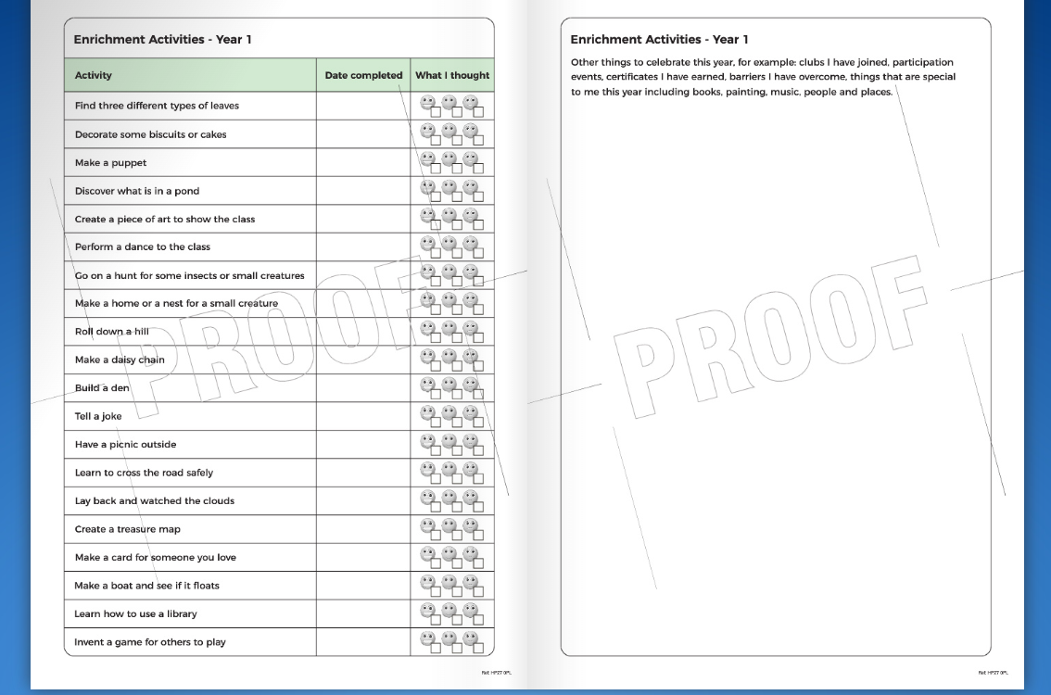

Slide 18
Additional Drop in Sessions
On Mondays after school, 3.30-4pm, in the Year 1 Classroom.
Starting from Monday 21st September.
You do not need to make an appointment, but you will need to sign in at the Office.
This is not an opportunity to look at books and work, but you will be able to see these at the October Parents Evening.

Slide 19
Pick up and drop off information
Main gates open from 8:30am
Children are welcome into the classrooms from 8:40am
Register closes at 8:55am
Gates to parents open at 3:00pm
Pupils led out at 3:15pm
The children will all come outside and wait by the wall. Once all children are outside, we will send them to their Parents/Carers. Please don’t call your child to you, as they have been told to wait until myself or Miss Barnes has let them go.

Slide 20
Pick up information
If your child is going home with someone else, please make sure you let us know. E.g. if they are going to a friends house, Grandparents will be collecting and they don’t usually.
The easiest way to do this is to let Mrs Mayman know in the morning and she will then let me know. Alternatively, you can let the Office know and they will pass this on.
Thank you in advance, it just makes things easier at home time.
Notes:
This is 5 minutes earlier than usual, a letter will go out about this.

Slide 21
Contact Information
If you need to contact us, please email the Office – office@jlg.odbst.org who will forward the email to class teachers where necessary, or alternatively reply back with an answer if they can.
Please be aware that we do not reply to emails during the day as we are teaching.
Friday News has all the information about what we have been learning during the week.
If it is urgent phone the Office on 01844 343521

Slide 22
Finally
Please could we request some boxes of tissues for the class – thank you.
Any worries, concerns or questions, please let us know – email the Office, or ask at pick up/drop off. Alternatively drop in on a Monday after school and I can help.
Are there any questions?
Thank you all for coming.
This presentation will be sent out and put on the School Website if you need to see any information again.

