Slide 1


Meet the Teacher
Year 3

Slide 2

Vision and Values
We start the year reminding everyone of our vision and values. As a Church school we have a distinctive character where Christian values are promoted in all aspects of school life.
Nurturing potential for all within a Christian ethos
"Therefore, encourage one another and build each other up"
1 Thessalonians 5:11 (NIV)
Together we will work to enable all our children to achieve their full potential within our Christian family. Through the teachings and examples of Jesus, we nurture individuality - providing challenge, developing self-esteem and promoting care and respect for each other and God’s world.

Slide 3
Introducing the team
Miss Moulder (Monday – Thursday)
Miss Holland (Thursday morning and Friday)
Mrs Cassap

Slide 4
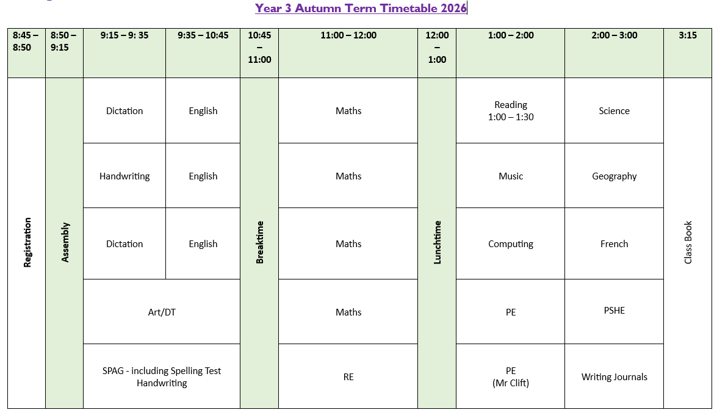
Timetabling

Slide 5
Timetabling
PE
Thursday and Friday.
Please ensure that children wear their PE kits to school on these days.
Kit should include the following: trainers, jogging bottoms/leggings, t-shirt, shorts and a fleece/hoody.
Earrings will need to be removed for PE lessons.
If they attend an after-school club, where they need to change, they will be given the opportunity at the end of the day for it.

Slide 6
Timetabling
Topics covered this year include:
Autumn Term: Mountains and Anglo Saxons – trip to Amersham Open Air Museum
Spring Term: Energy and Vikings
Summer Term: Earthquakes and Egyptians
The class pages and school website will have further information about the curriculum – e.g for Knowledge Organisers

Slide 7

Equipment List
Pencil case including:
Pencil
Colouring pencils
Sharpener
Ruler
Eraser
Whiteboard pens
Glue stick
Handwriting pen (when pen licence has been issued)
Donations of tissue boxes would also be very welcome. The children use lots of tissues, especially in the colder months!

Slide 8
Expectations
This year, housepoints are going to be awarded for children who demonstrate additional effort either in lessons or supporting others around the school. The emphasis will be leadership, kindness and service.
There is an expectation that children will read at least 3 x a week and this should be recorded in their reading records.
Additional housepoints will be awarded for children who want to share books with the class and / or inspire others.
Exceptional effort with pieces of work will be copied and sent home and a record kept in the children’s passport
Please remember to encourage children to share achievements out of school with us in our Celebration Assemblies on Wednesdays

Slide 9
Responsibilities
Children are issued with a cloakroom locker in KS2. They must put their rucksacks and belongings in their locker each morning and collect them at the end of the day. Please label everything!
The children will be expected to place their reading diary in the box and their water bottle in the tray when they enter the classroom. Pencil cases should be placed on their desk.
Children are allocated a role such as book monitor, water bottle monitor or chair stacker.
Roles are changed every half term so all children will have a responsibility during a term.

Slide 10
The importance of reading
It must be signed by parents and not by the children.
If possible, please listen to your child read and discuss the book with them asking them to discuss what has happened and to make predictions about what might happen next.
Children should read a variety of texts including fiction and non-fiction.
They can borrow books from the classroom book corner and the school library. Some children will also be given a book from the school scheme.

Slide 11
Homework
Daily reading preferably to an adult.
Weekly spellings which will be issued on a Friday and tested the following Friday.
Times tables which are tested in class every Thursday. These are best practised daily. Say them on the way to school, in the car, in the supermarket - whenever you have a spare five minutes!

Slide 12
Pick up and drop off information
Gates open from 8:30am
Pupils enter school 8:40am
Register closes at 8:50am
Gates open at 3:00pm
Pupils let out at 3:15pm

Slide 13
Additional drop-in sessions for parents
This year we are providing a weekly drop-in session should you wish to meet and talk about any concerns.
These will take place on Tuesday between 3.30 and 4.00. You do not need to make an appointment, but you will need to sign in at the office.
This is not an opportunity to look at books and work – that opportunity will be available during the October parents evening.

Slide 14
Contact information
Email office who will forward to class teachers
Please be aware that we do not answer during the day as we are teaching
Friday News has all the information about what we have been learning during the week
If it is urgent phone the office 01844 343521

