Slide 1


Meet the Teacher
Friday 4th September

Slide 2

Vision and Values
We start the year reminding everyone of our vision and values. As a Church school we have a distinctive character where Christian values are promoted in all aspects of school life.
Nurturing potential for all within a Christian ethos
Together we will work to enable all our children to achieve their full potential within our Christian family. Through the teachings and examples of Jesus, we nurture individuality - providing challenge, developing self-esteem and promoting care and respect for each other and God’s world.
‘Therefore, encourage one another and build each other up’
1Thessalonians 5:11

Slide 3
The Year 5 Team
Mrs Thomas (Monday, Tuesday, Wednesday)
Mrs Mahajan (Thursday, Friday)
Support from Miss Madelin every morning and Mrs Haycock 2 afternoons

Slide 4
Timetabling
PE days (PE will be on Mondays with Mr Norton and Games with the coach will be on Tuesdays )
This year, the children are encouraged to come to school in their PE kits on PE days
Specialised singing sessions after half term (Wednesday pm)
Topics this year include: The Victorians, Fairtrade, Crime and Punishment, Rivers, Ancient Greeks, Mapping
Look on the class page for Knowledge Organisers and information

Slide 5
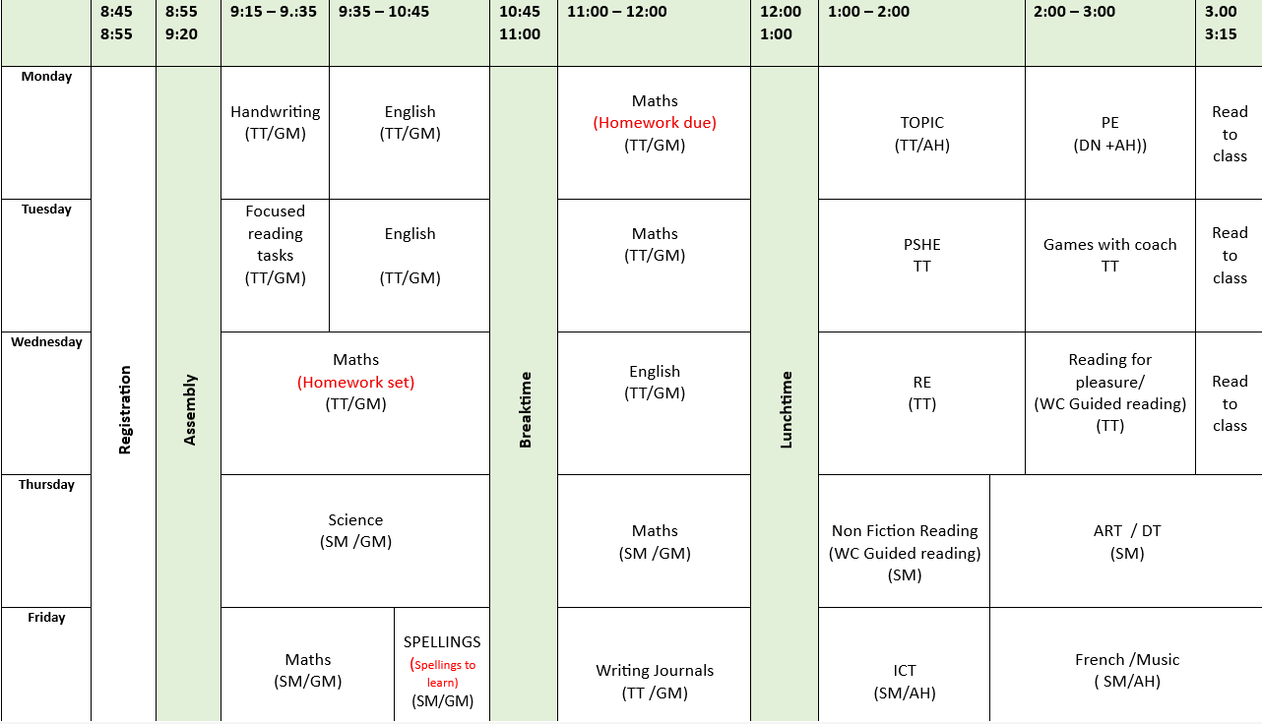
Timetable

Slide 6
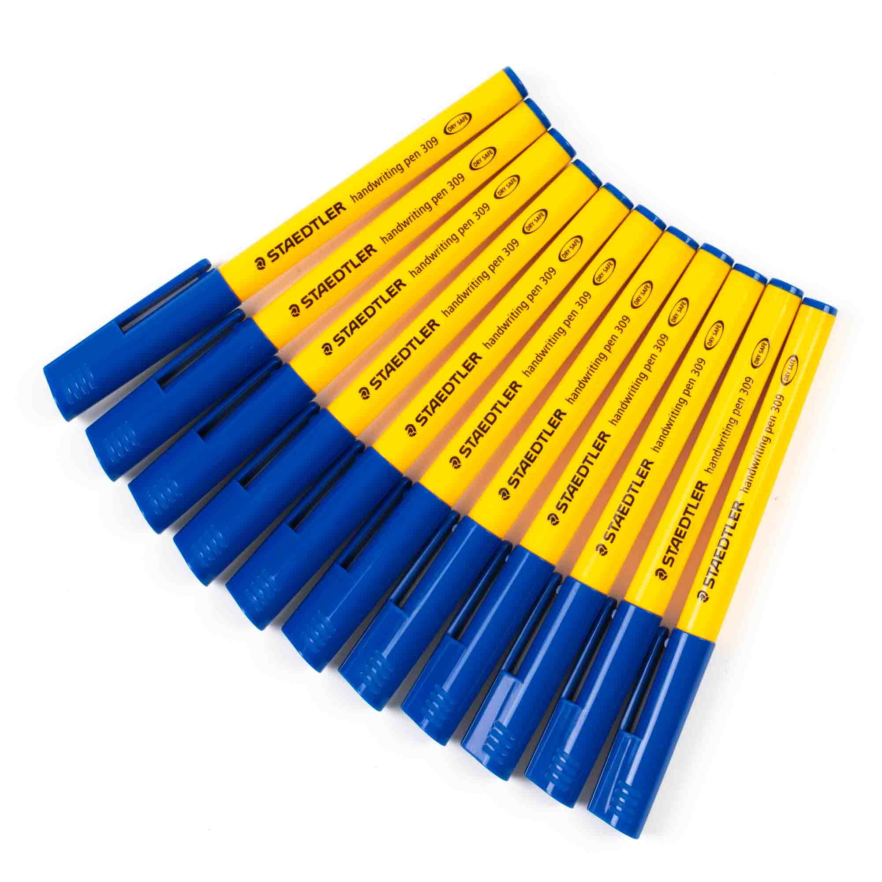



Equipment List
The children need a fully stocked pencil case that needs to be refreshed each half term.
They will need:
Blue handwriting pens (Not biro, Pilot Frixon are good but expensive)
Whiteboard pens
Pritt Sticks
Pencils
Eraser
Sharpener
Coloured pencils
15cm ruler
Protractor
Compass
A folder to store things in

Slide 7
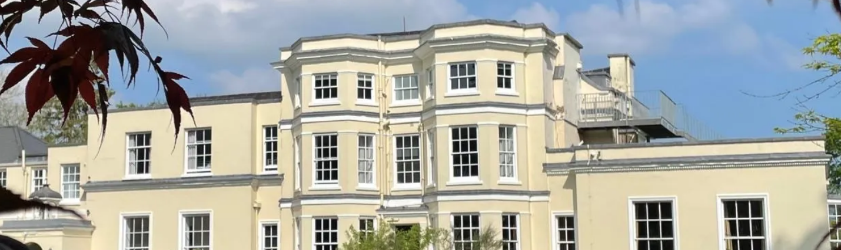
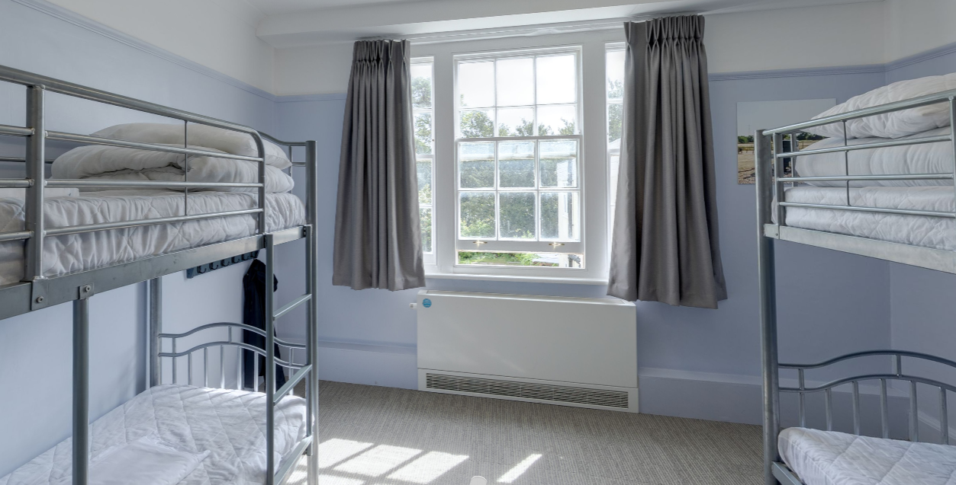
Trips
1 night residential trip to Woodrow Centre in Amersham
Dates: Thursday 4th March – Friday 5th March (2 days of activities + 1 night)
Deposit will be asked for shortly

Slide 8
Rewards and Expectations
This year, housepoints are going to be awarded for children who demonstrate additional effort either in lessons or supporting others around the school. The emphasis will be leadership, kindness and service
There is an expectation that children will read at least 5 x a week and this should be recorded in their reading records. Additional housepoints will be awarded for children who want to share books with the class and / or inspire others.
Exceptional effort with pieces of work will be copied and sent home and a record kept in the children’s passport
Please remember to encourage children to share achievements out of school with us in our Celebration Assemblies on Wednesdays

Slide 9
The importance of reading
It is still important to monitor children’s reading in Year 5
Your child may not want to read out loud but talking about what they’ve read and discussing new vocabulary will greatly support their learning across the curriculum
Some familiar and safe books are perfect for bedtimes. Books from the Year 5 reading list will help them make progress. REMEMBER You can read with them too.
Please encourage them to get their reading record signed- it is a record of how often they are reading and helps us monitor progress
In Year 5 children can read with and to Year 1 children on a rota basis

Slide 10

Homework
In Year there will be a weekly maths homework and weekly spelling homework.
Maths is set on Wednesdays and should be returned on Mondays.
Spellings are set on a Friday and will be reviewed the following Friday. A list of each half term’s spellings will be put on the class page
In addition to reading, children are encouraged to continue to practise their times table and number bond fluency. (White Rose Maths 1 minute app is particularly useful)
There will be an opportunity to do any homework tasks at 12o’clock at the Y5 homework club. Some children use this time to catch up with their reading too.

Slide 11
Pick up and drop off information
Main gates open from 8:30am
Children are welcomed into the classrooms from 8:40am
Register closes at 8:55am
Gates to parents open at 3:00pm
Pupils led out at 3:15pm
Children in Year 5 are allowed to walk home or to the village hall but only when we have official notification via email

Slide 12
Testing and assessments in Year 5
Most assessments for Year 5 will be end of unit activities
There will be a reading comprehension assessment this half term.
Other assessments closely linked to SATS in Year 6 will take place in the summer term
There will no longer be NFER CATS testing in Year 5

Slide 13
Additional drop-in sessions for parents
This year we are providing a weekly drop-in session should you wish to meet and talk with either of us about any concerns.
These will take place on Thursdays between 3.30 and 4.00. You do not need to make an appointment, but you will need to sign in at the office.
This is not an opportunity to look at books and work – that opportunity will be available during the October parents evening.

Slide 14
Additional information
The children are not permitted to wear Smart watches at school
We discourage children from having mobile phones at school, but should they need one for any reason, this should be handed in at the office.
In the Christmas production, the children will be required for all 4 performances. For 2 they will be a member of the choir and for 2 they will be on stage

Slide 15
Contact information
Email office who will forward to class teachers
Please be aware that we do not answer during the day as we are teaching
Friday News has all the information about what we have been learning during the week
If it is urgent phone the office 01844 343521

