Slide 1


Meet the Teacher
Thursday 3rd September 2026

Slide 2

Vision and Values
We start the year reminding everyone of our vision and values. As a Church school we have a distinctive character where Christian values are promoted in all aspects of school life.
Nurturing potential for all within a Christian ethos
"Therefore, encourage one another and build each other up"
1 Thessalonians 5:11 (NIV)
Together we will work to enable all our children to achieve their full potential within our Christian family. Through the teachings and examples of Jesus, we nurture individuality - providing challenge, developing self-esteem and promoting care and respect for each other and God’s world.

Slide 3
The Year 6 Team
Mr Norton
Mrs Mahajan (Wednesday)
Support from Mrs Padula

Slide 4
Timetabling
PE days (PE will be on Mondays and Games with the coach will be on Tuesdays) The children are able to wear their PE kits into school on their PE days.
Topics this year include:
Victorians, Crime and Punishment, Ancient Greece, Fair Trade and Rivers
Look on the class pages for Knowledge Organisers and information

Slide 5
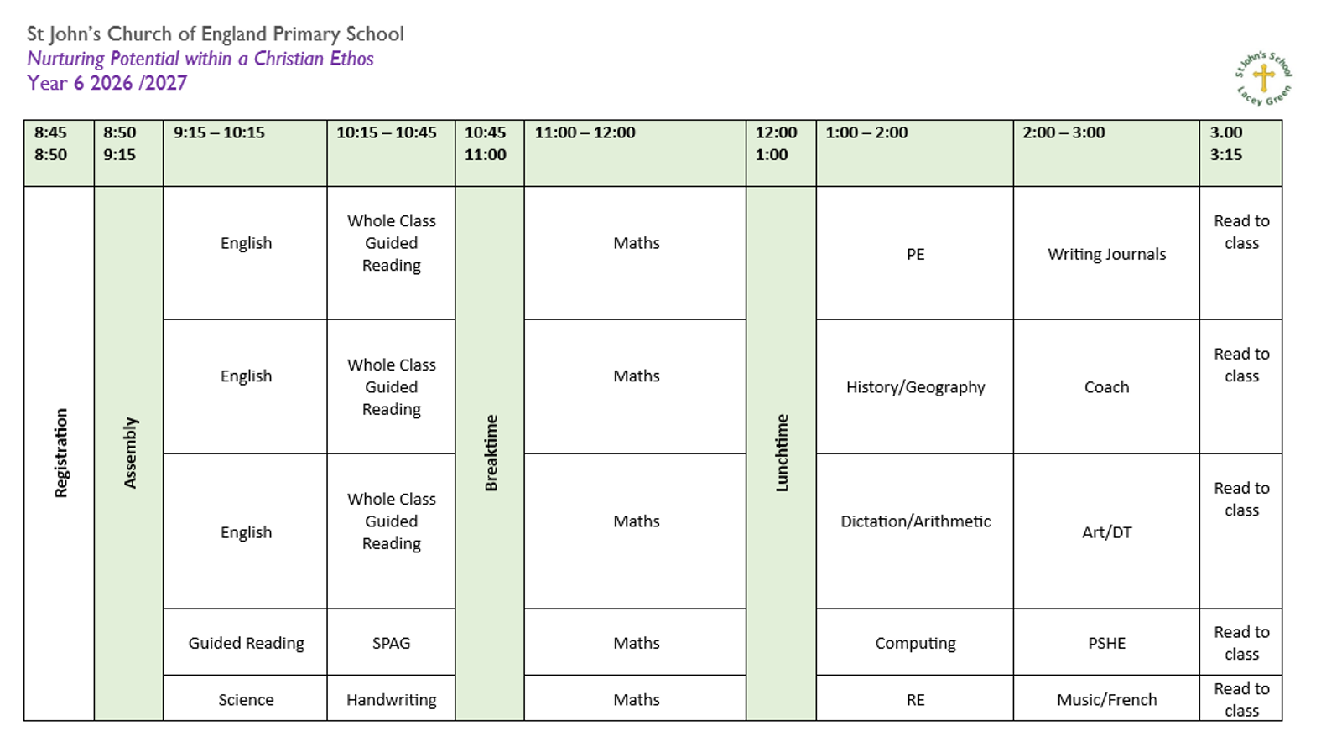
Timetable

Slide 6
Expectations
The children are top of the school and will be encouraged to take on positions of responsibility next year.
We expect them to be the role models and demonstrate the school values and high expectations for behaviour. Intrinsic motivations!
In Year 6, all children will be encouraged to write in pen (except in maths).

Slide 7
The importance of reading
It is still important to monitor children’s reading in Year 6
Please encourage them to get their reading record signed- again they are role models for the younger children.
Example reading lists with good recommendations:
Best Books for Year 6 | Ages 10-11 | The Reader Teacher
Books for Year 6 children aged 10-11 | School Reading List
Best Books for Year 6 (2026 Booklist): 50 Recommended Reads
https://padlet.com/rruddick9zra/graphic-novels-73uh2srzpbia

Slide 8
Homework
Homework has been reduced in Year 6. For the rest of the school, there will only be a focus on reading, spellings and timetables.
In Year 6, we will be asking the children to complete a weekly maths sheet and occasionally some additional work from another subject. Maths homework will be set on a Wednesday and due in on a Monday.
Spellings will be on the class page – Weekly tests will continue to be on a Thursday like they were in Year 5.

Slide 9

Hazard Alley – Autumn Term
Hazard Alley is the world’s first interactive indoor safety education centre. It was planned and established in 1992 and was officially opened by HRH The Duchess of Gloucester in 1994.
Originally conceived by Bucks Fire & Rescue Service & Thames Valley Police, it aimed to introduce children to risks, dangers and hazards in a totally safe environment.
By creating everyday scenarios that children can walk into, we developed a learning environment where children can explore, investigate, discover and imagine in complete safety.

Slide 10
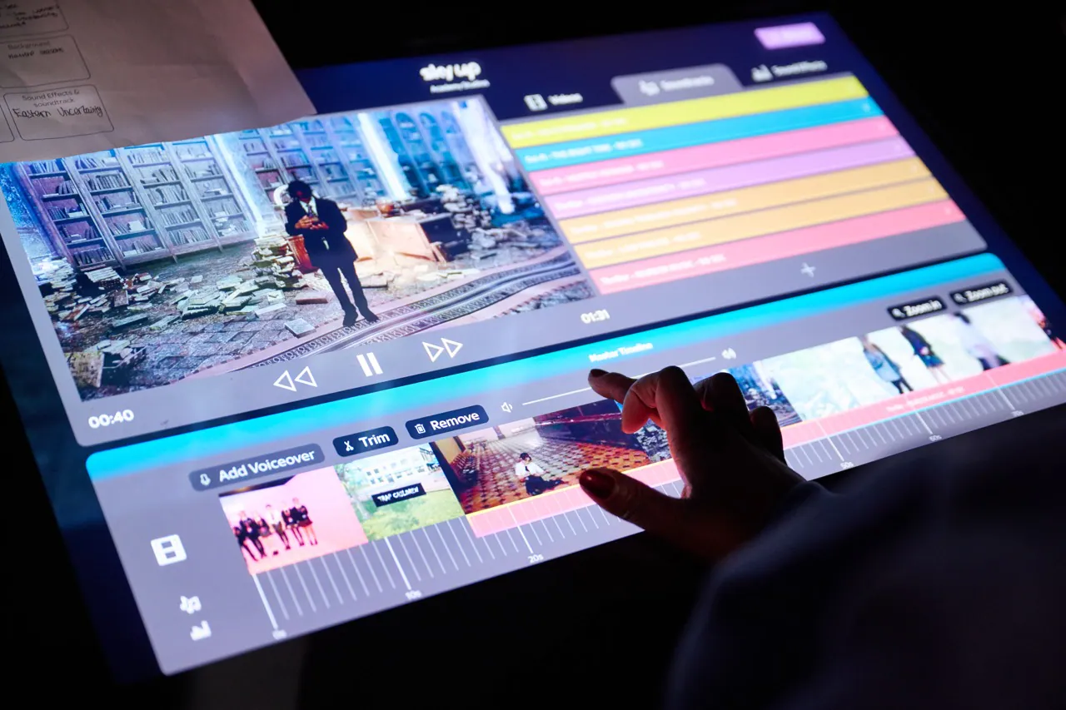
Elstree Studios – Spring Term – Hopefully!!
At Sky’s bespoke TV studios, your students will use our cutting-edge digital technology to create their own exciting digital content. They'll take on real-life media roles and work with our team of experts, to create a news report, trailer or film pitch idea.
A visit to Sky Up Academy Studios will give your class a VIP peek behind-the-scenes at Sky, helping develop their confidence and build key digital skills and other essential skills for the future such as Creativity, Communication, and Collaboration.

Slide 11

PGL Osmington Bay– Summer Term – Wednesday 9th June – Friday 11th June 2027

Slide 12

PGL Osmington Bay– Summer Term

Slide 13

PGL Osmington Bay– Summer Term
🌊 3 days, 2 nights on Dorset’s Jurassic Coast
Initial deposit: £45
Payable via the MCAS app – you will be notified when payment goes live
Please pay by Monday 21st September 2026 to secure your child’s place
Once we know the exact number of children attending, the full cost and payment schedule will be emailed to parents
We hope every child will be able to join us for a fantastic Year 6 experience!

Slide 14
Pick up and drop off information
Main gates open from 8:30am
Children are welcomed into the classrooms from 8:40am
Register closes at 8:55am
Gates to parents open at 3:00pm
Pupils led out at 3:15pm

Slide 15
Contact information
Email office who will forward to class teachers
Teachers will now be offering weekly drop-in sessions. My session will be from 3:30-4:00 every Thursday!
Friday News has all the information about what we have been learning during the week.
If it is urgent phone the office 01844 343521

