Slide 1


Meet the Teachers
Year 3
Tuesday 1st July 2025

Slide 2

Vision and Values
As a Church school we have a distinctive character where Christian values are promoted in all aspects of school life.
Nurturing potential for all within a Christian ethos
Together we will work to enable all our children to achieve their full potential within our Christian family. Through the teachings and examples of Jesus, we nurture individuality - providing challenge, developing self-esteem and promoting care and respect for each other and God’s world.
‘I can do all things through Christ who strengthens me’ Philippians 4:13

Slide 3
Introducing the team
Class Teachers
Mrs Farrell (mornings)
Mrs Mayman (afternoons)

Slide 4
Timetabling
PE days: Monday am and Friday pm
PE kit in school every day please. The children will come home wearing their PE kit on Friday.
Kit should include the following: trainers, jogging bottoms/leggings, t-shirt, shorts and a fleece/hoody.

Slide 5
Topics
Autumn: Europe and Prehistoric Ages
Spring: Biomes and the Roman Empire (Trip to St. Albans museum)
Summer: The Far East and Monarchs Through Time

Slide 6

Equipment List
Pencil case including:
Pencil
Colouring pencils
Sharpener
Ruler
Eraser
Whiteboard pens
Glue stick
Handwriting pen (when pen licence has been issued)
Donations of tissue boxes would also be very welcome. The children use lots of tissues, especially in the colder months!

Slide 7
The importance of reading
Children are awarded house points for every signed entry in their reading diary.
It must be signed by parents and not by the children.
If possible, please listen to your child read and discuss the book with them asking them to discuss what has happened and to make predictions about what might happen next.
Children should read a variety of texts including fiction and non-fiction.
They can borrow books from the classroom book corner and the school library. Some children will also be given a book from the school scheme.

Slide 8
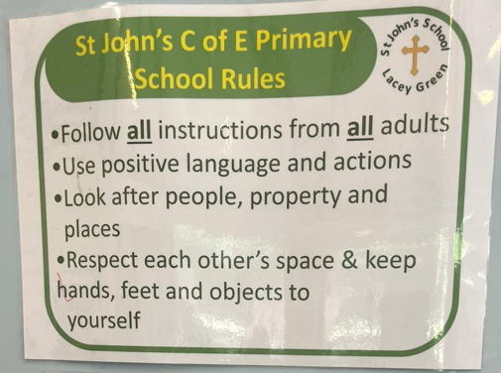
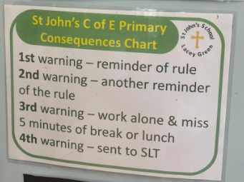
Rules, Rewards & Consequences
We follow the school rules and apply consequences consistently:
Rewards include house points, table points, raffle tickets, certificates and whole class merits.

Slide 9
Expectations
Respectful behaviour
Classroom rules to be followed e.g. working quietly (classroom noise levels); they will be agreed with the children in September
Presentation of work: date, underline, miss a line, LO, underline, miss a line, start (DUMLUMS)

Slide 10
Responsibilities
Children are issued with a cloakroom locker in KS2. They must put their rucksacks and PE bags in their locker each morning and collect them at the end of the day. Please label everything!
The children will be expected to place their reading diary in the box and their water bottle in the tray when they enter the classroom. Pencil cases should be placed on their desk.
Children are allocated a role such as book monitor, water bottle monitor or chair stacker.
Roles are changed every half term so all children will have a responsibility during a term.

Slide 11
Homework
Daily reading preferably to an adult.
Weekly spellings which will be issued on a Monday and tested the following Monday.
Times tables which are tested in class every Friday. These are best practised daily. Say them on the way to school, in the car, in the supermarket - whenever you have a spare five minutes!

Slide 12

New this year –St. John’s passport
This is an A5 booklet similar in size and style to the KS2 reading record books.

Slide 13
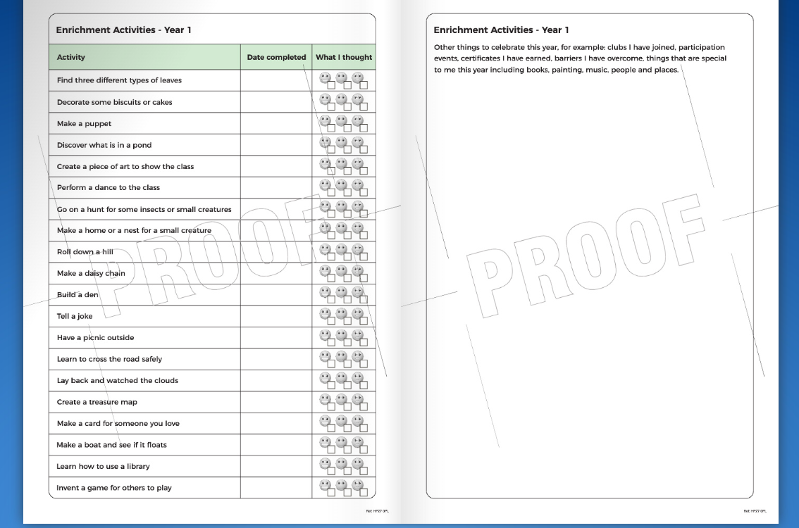

Slide 14
Pick up and drop off information
Main gates open from 8:30am
Children are welcomed into the classrooms from 8:40am
Register closes at 8:55am
Gates to parents open at 3:00pm
Pupils led out at 3:15pm

Slide 15
Parent Help
We would very much welcome any support or time you or other relatives such as grandparents could give us.
Support with reading
Library
Computing
Sewing
Art
Please let us know if you think you can help and your availability either by email or after the meeting.

Slide 16
Contact information
You can email the school office who will forward messages to class teachers: office@jlg.odbst.org
Please be aware that we are unlikely to reply during the school day as we will be teaching.
Friday News on the school website has all the information about what we have been learning during the week.
If something is urgent, please phone the school office on: 01844 343521

Slide 17

Any questions?

