Slide 1


Year 5 - Meet the Teacher
Wednesday 9th July 2025

Slide 2

Vision and Values
We expect EVERYONE (including parents) to live them!
Nurturing potential for all within a Christian ethos
Together we will work to enable all our children to achieve their full potential within our Christian family. Through the teachings and examples of Jesus, we nurture individuality - providing challenge, developing self-esteem and promoting care and respect for each other and God’s world.
‘I can do all things through Christ who strengthens me’ Philippians 4:13
As a Church school we have a distinctive character where Christian values are promoted in all aspects of school life.

Slide 3
Introducing the team
Mr Norton, Mrs Harrison (Monday – Thursday), Miss Holland (Friday)
Two small Year 5 classes

Slide 4
Equipment List
Blue handwriting pens (not biros) Swash, Edding or Frixon pens are good.
Writing pencils (HB)
Eraser
Sharpener
Ruler
Coloured Pencils
Scissors
Pritt Sticks/ Glue Sticks – 1 per half term (replaced when needed)
Whiteboard Pens – 1 per half term (replaced when needed)

Slide 5
Homework
Homework for Year 5 will be daily reading and times table practice.
Research has proved that children that are supported regularly with these aspects of learning feel more confident and secure with accessing learning in the classroom.
Other ways to support your child include engaging with the knowledge organisers (these have key questions and vocabulary related to each topic).
Spellings will also be sent home once a week on a Thursday, and the children will be informally tested on these on the following Thursday. Children learn spellings in different ways - daily, look, cover, write check, works for some; saying them out loud; writing in different coloured pens; sometimes we will send you a link to a spelling game on the computer.

Slide 6
Reading
Reading is still an important focus within the curriculum – which is the case for secondary schools as well as primary schools.
The children will be given a recommended reading list that will provide them with enough challenge and appropriate vocabulary for Year 5.
Best Books for Year 5 (Ages 9-10): Recommended Booklist (booksfortopics.com)
Best Books for Year 5 | Ages 9-10 | The Reader Teacher
Even if your child is an independent and regular reader, please keep listening to them and talking to them about what they are reading. Improving vocabulary is a valuable skill and children need support with this.
In Key Stage 2, we have additional reading fluency bands to strength and challenge

Slide 7
Rules and Rewards
Children work hard to earn house points throughout the year. ​
They will be awarded bronze, silver, gold and platinum certificates when they reach 50, 100, 150 and 200 house points. These are presented and celebrated in special assemblies.​
Children can earn house points each day by filling in their reading record and practising their times tables. Bonus house points are awarded for a full week of reading.
Golden house points (worth 5 house points) or headteacher’s awards are given for exceptional work or effort.​
Children are also rewarded for kind and helpful behaviour.
Class Merits are also collected throughout the year where the class have shown great attitude, determination or behaviour. Once 10 have been achieved 10 the children get to choose a class treat.

Slide 8
Enrichment activities
Services in the Church throughout the year
Young Voices Concert (4th February 2026)
London Science Museum sleepover (Friday 13th March 2026)
Additional Activity – Summer Term - TBC
Sport – School teams, Year 5/6 events

Slide 9

Young Voices 2026 – 4th February 2026
Young Voices concerts take place every January and February at major arenas across the UK.
Before the big day, schools receive a full music pack with songs, choreography and easy-to-follow teaching resources – no music experience needed. Our aim is to make singing as accessible and enjoyable as possible for every teacher and pupil.
On the concert day, choirs of up to 9,000 children rehearse together for the first time, then perform in an unforgettable evening performance with special guests and spectacular sound and lighting.
It’s a high-energy, confidence-boosting experience that creates lasting memories for everyone involved.
How does it work? | Young Voices

Slide 10
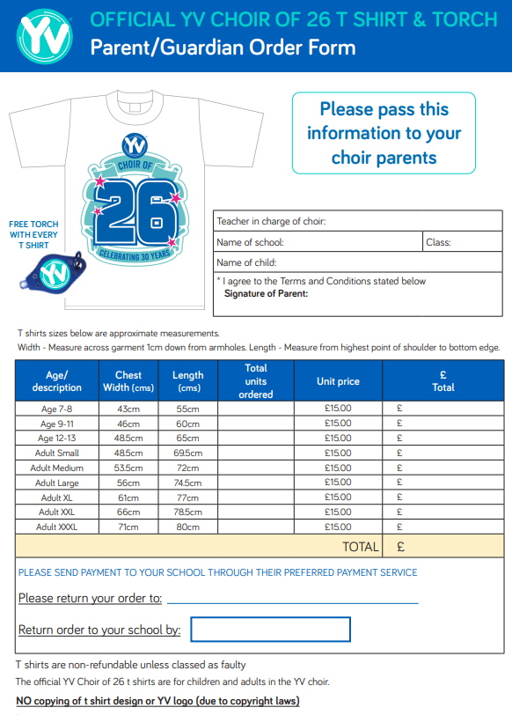
Young Voices 2026 – 4th February 2026
Completed form back to Mr Norton by Wednesday 16th July

Slide 11
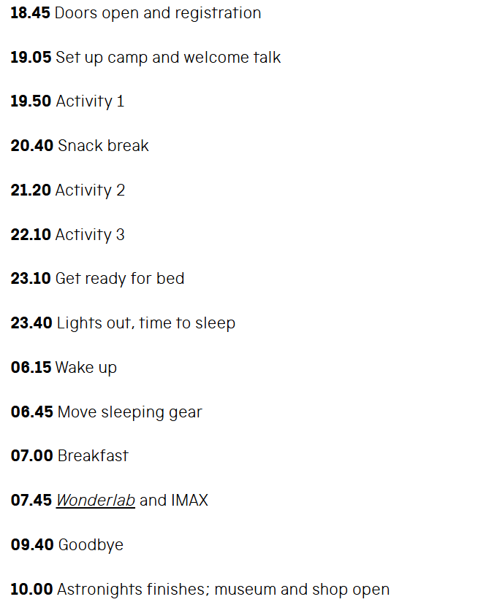
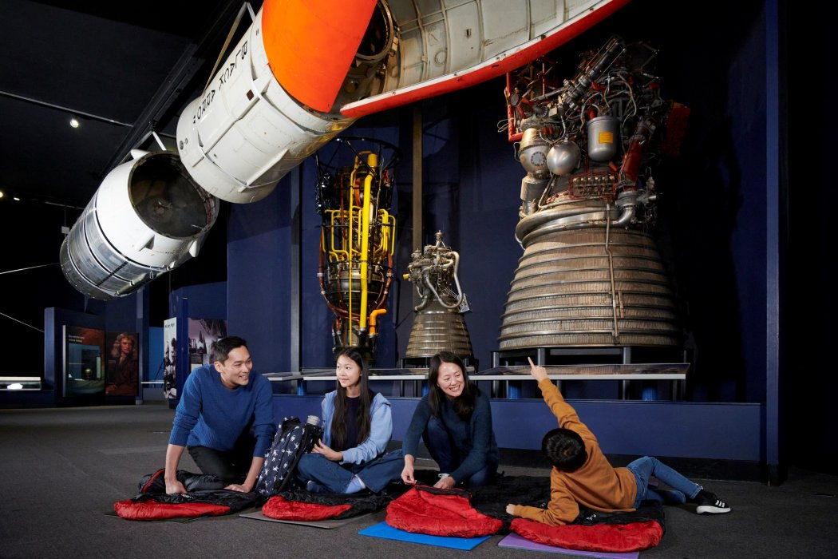
Science Museum – Astronights – Friday 13th March

Slide 12
Costings
Science Museum (Friday 13th March 2026) – Astronights - £87.80, Coach - £21, Evening Meal – approx £17.50 = £126 approx
Young Voices Concert (4th February 2026) - Total cost - £36.14
Audience Tickets – PLEASE ORDER YOUR OWN - £27
https://yvmusicroom.com/auth/parent/login

Slide 13
Pick up and drop off information
Gates open form 8:30am
Pupils enter school 8:40am
Register closes at 8:55am
Gates open at 3:00pm
Pupils led out at 3:15pm

Slide 14
Contact information
In the first instance, please email the office with any queries or questions - office@jlg.odbst.org - who will forward to class teachers if it is necessary.
Please be aware that we do not answer during the day as we are teaching but will reply when we can.
If it is urgent phone the office 01844 343521

Slide 15
And finally…
Any help with computing, reading, art and DT would be most gratefully received.
Any questions??

