Slide 1


Meet the Teacher
Tuesday 8th July

Slide 2

Vision and Values
We start the year reminding everyone of our vision and values. As a Church school we have a distinctive character where Christian values are promoted in all aspects of school life.
Nurturing potential for all within a Christian ethos
Together we will work to enable all our children to achieve their full potential within our Christian family. Through the teachings and examples of Jesus, we nurture individuality - providing challenge, developing self-esteem and promoting care and respect for each other and God’s world.
‘I can do all things through Christ who strengthens me’ Philippians 4:13

Slide 3
The Year 6 Team
Mrs Thomas (Monday, Tuesday, Wednesday)
Mrs Mahajan (Thursday, Friday)
Support from Mrs Horton

Slide 4
Timetabling
PE days (PE will be on Wednesdays and Games with the coach will be on Tuesdays )The children will be able to come home in their PE kits on Wednesdays.
Specialised singing sessions after half term (Wednesday pm)
Topics this year include: Rainforests, Climate Change, Volcanoes, The Mayan Civilisation, World War 2 and Leisure across the 20th Century
Look on the class pages for Knowledge Organisers and information

Slide 5
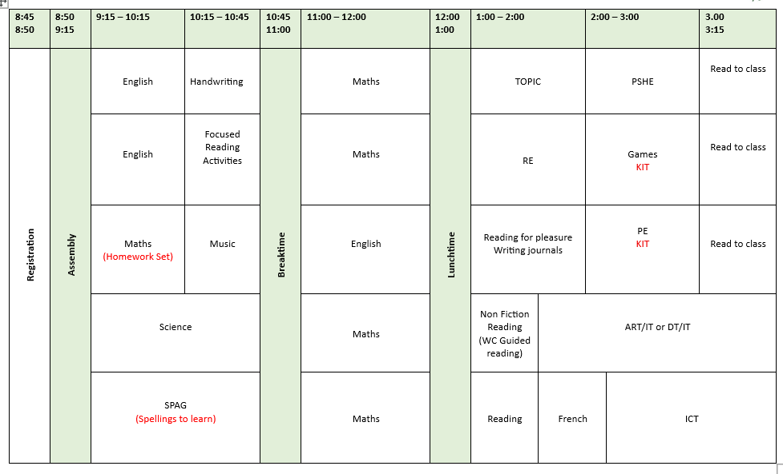
Timetable

Slide 6
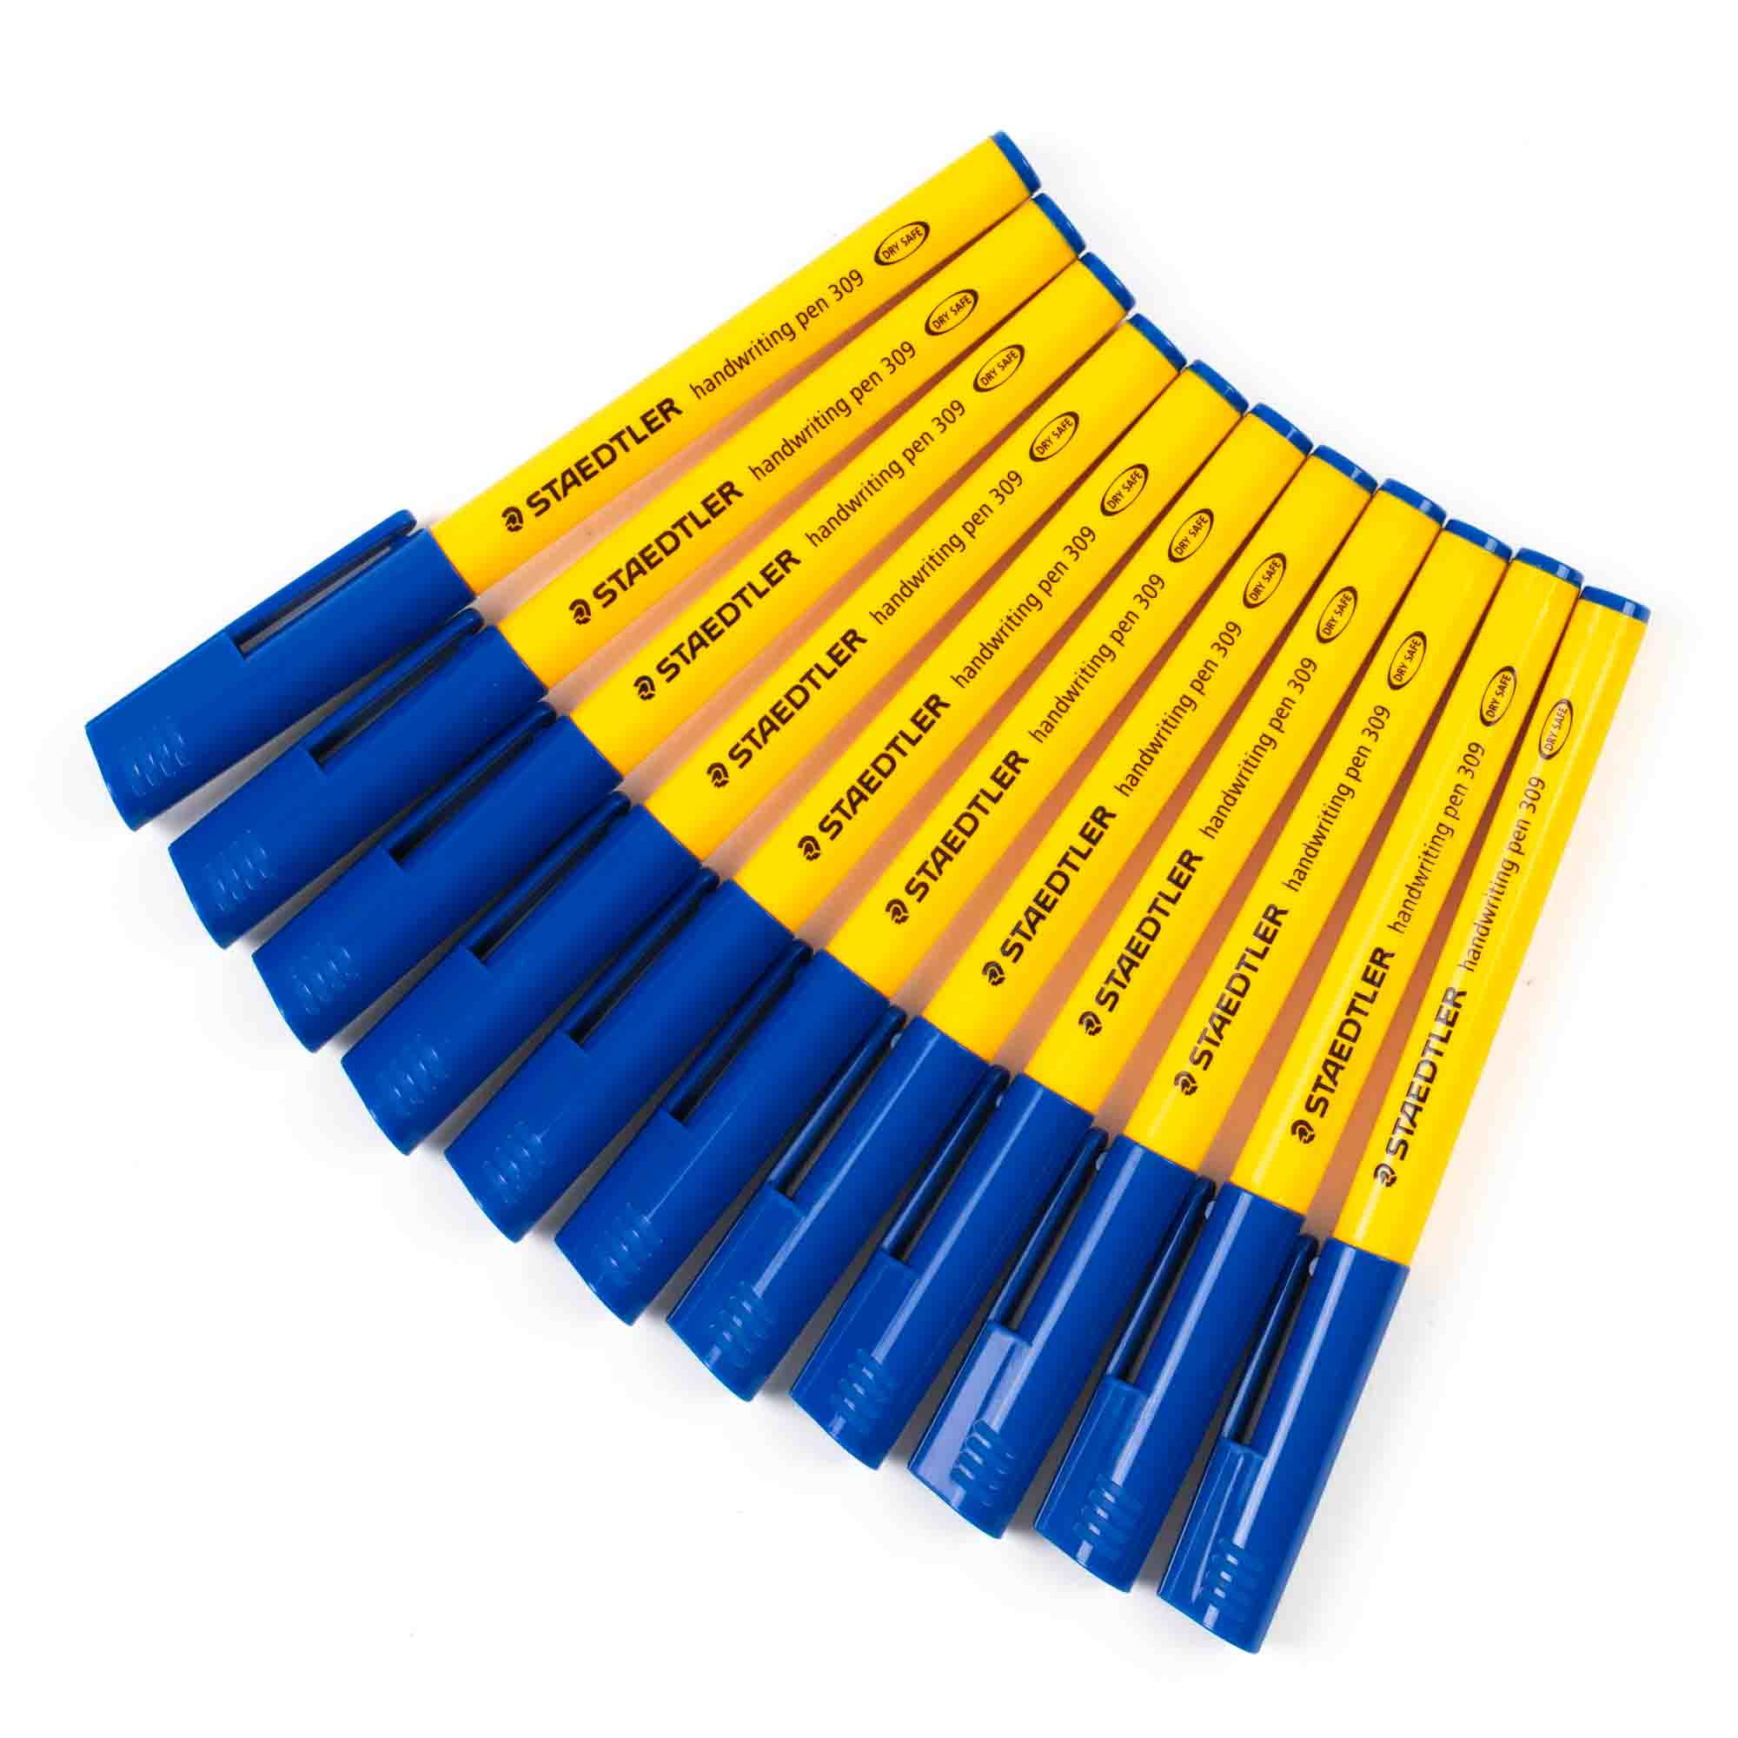



Equipment List
The children need a fully stocked pencil case that needs to be refreshed each half term.
They will need:
Blue handwriting pens (Not biro, Pilot Frixon are good but expensive)
Whiteboard pens
Pritt Sticks
Pencils
Eraser
Sharpener
Coloured pencils
15cm ruler
Protractor
Compass
A folder to store things in

Slide 7
Trips
We hope to go to Hazard Alley in Milton Keynes in the Autumn Term
We are currently in negotiation with Whitemoor Lakes regarding the residential trip. As soon as we know, we will let you know.
We will set up a payment plan that will cover the cost of both trips so that it can be spread across the year.
Deposits are usually needed in the first 2 weeks back in September.

Slide 8
Expectations
The children are top of the school and will be encouraged to take on positions of responsibility next year.
We expect them to be the role models and demonstrate the school values and high expectations for behaviour.
In Year 6, all children will be encouraged to write in pen (except in maths).
We will still be using the DUMLUMS approach to presentation of all pieces of work

Slide 9
The importance of reading
It is still important to monitor children’s reading in Year 6
Your child may not want to read out loud but talking about what they’ve read and discussing new vocabulary will greatly support their learning across the curriculum
Some familiar and safe books are perfect for bedtimes. Books from the Year 6 reading list will help them make progress. REMEMBER You can read with them too.
Please encourage them to get their reading record signed- again they are role models for the younger children.

Slide 10
Homework
Homework has been reduced in Year 6. For the rest of the school, there will only be a focus on reading, spellings and timetables.
In Year 6, we will also be asking the children to complete a weekly maths sheet and occasionally some science.
There will be an opportunity to do any homework tasks at 12o’clock at the Y6 homework club. Some children use this time to catch up with their reading too.

Slide 11
Pick up and drop off information
Main gates open from 8:30am
Children are welcomed into the classrooms from 8:40am
Register closes at 8:55am
Gates to parents open at 3:00pm
Pupils led out at 3:15pm

Slide 12
Parent helpers
We welcome support from parents next year.
Regular support with Art / DT /ICT is always useful – we will also be sewing at some point
Hearing children read or helping in the library
Support with one off projects like scenery or costumes for the Christmas play

Slide 13
Contact information
Email office who will forward to class teachers
Please be aware that we do not answer during the day as we are teaching
Friday News has all the information about what we have been learning during the week
If it is urgent phone the office 01844 343521

