Slide 1


Meet the Teacher – Year 2
Monday 7th July

Slide 2

Vision and Values
We expect EVERYONE (including parents) to live them!
Nurturing potential for all within a Christian ethos
Together we will work to enable all our children to achieve their full potential within our Christian family. We nurture individuality - providing challenge, developing self-esteem and promoting care and respect for each other and God’s world.
‘I can do all things through Christ who strengthens me’ Philippians 4:13
As a Church school we have a distinctive character where Christian values are promoted in all aspects of school life.

Slide 3
Introducing the team
Miss Moulder (Monday – Thursday)
Mrs Rae (Fridays)
Mrs Cassap
Mrs Haycock

Slide 4
Timetabling
PE days – Friday with the second date tbc – please ensure that PE kits are in school every day.
Topics covered this year include:
The UK, Africa and The coast in Geography
The Great fire of London, Lives of Significant Individuals and Grace Darling in History
The class pages and school website will have further information about the curriculum – e.g for Knowledge Organisers

Slide 5
How is Year 2 different to Year 1?
Children will continue to build up reading fluency and read longer books. When appropriate short chapter books.
Number knowledge will extend to numbers up to 100.
They will begin to learn times table facts x2, x5, x10 later in Year 2
Learn more joins for joined up handwriting when appropriate
Write longer pieces and use additional punctuation (commas in list, apostrophes for possession and contraction)

Slide 6



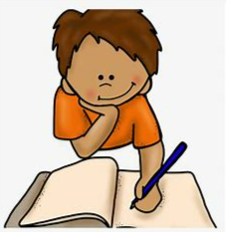

Curriculum
In the mornings the children will have the following subjects
SPaG (spellings, punctuation and grammar)
Reading fluency
English and maths.
In the afternoon we begin with reading, either in groups, individual readers or reading for pleasure.
The rest of the afternoon will focus on the following curriculum subjects:
History/ Geography, Computing, Science, PE, Jigsaw (PSHE), Music, Art/ DT and RE.

Slide 7

Expectations
Respectful behaviour – following our school rules
Presentation of work – we expect children to take pride in all their work, including homework.
Please help your child practise drawing lines and underlining with a ruler.

Slide 8

The importance of reading
The children will continue to work through Little Wandle books according to the level that is appropriate for them.
The children will then move over to coloured bands (Purple, Gold, White, Lime and/ or Little Wandle Fluency books ).
Please record and sign your child’s reading record whenever they read to you. This is how children earn their house points! It must be signed by parents and not by the children.
If possible, please listen to your child read and discuss the book with them asking them to discuss what has happened and to make predictions about what might happen next.

Slide 9
Rules and Rewards
Children will continue to earn house points for reading, good work and following our school values.
Certificates are awarded in celebration assembly:
Bronze = 50, Silver = 100, Gold = 150 and Platinum = 200
Table Points – Where children work together to earn points
Class Merits – When the whole class have worked well together, they will be awarded a class merit. When they get 10, they will get to choose a class treat.

Slide 10
Homework
Homework for Year 2 will be daily reading and times table practice
(towards the end of Year 2) as well as number bonds.
Research has proved that children that are supported regularly with these aspects of learning feel more confident and secure with accessing learning in the classroom.
Other ways to support your child include engaging with the knowledge organisers (these have key questions and vocabulary related to each topic)
Spellings will also be sent home once a week, and the children will be informally tested on these the following week. Children learn spellings in different ways - daily, look, cover, write check, works for some; saying them out loud; writing in different coloured pens; sometimes we will send you a link to a spelling game on the computer.

Slide 11

New this year –St. John’s passport
This is an A5 booklet with a cardboard front cover. Similar in size and style to the KS2 reading record books

Slide 12
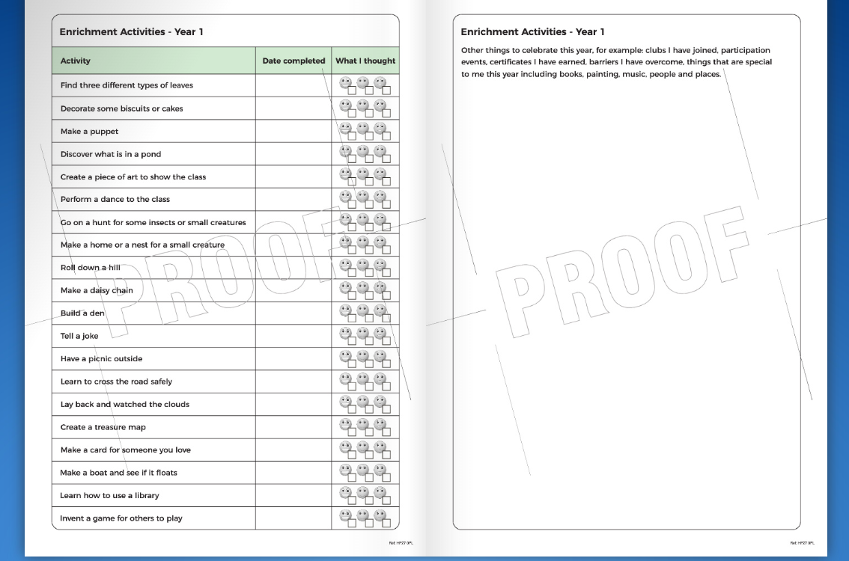

Slide 13
Pick up and drop off information
Gates open from 8:30am
Pupils enter school 8:40am (KS1 entrance – opposite Y2 classroom)
Register closes at 8:50am
Gates open at 3:00pm
Pupils let out at 3:15pm

Slide 14
Contact information
Email office who will forward to class teachers
Please be aware that we do not answer during the day as we are teaching
Friday News has all the information about what we have been learning during the week
If it is urgent phone the office 01844 343521

