Slide 1


Year 1 Meet the Teacher
Thursday 3rd July 2025

Slide 2

Vision and Values
We expect EVERYONE (including parents) to live them!
Nurturing potential for all within a Christian ethos
Together we will work to enable all our children to achieve their full potential within our Christian family. Through the teachings and examples of Jesus, we nurture individuality - providing challenge, developing self-esteem and promoting care and respect for each other and God’s world.
‘I can do all things through Christ who strengthens me’ Philippians 4:13
As a Church school we have a distinctive character where Christian values are promoted in all aspects of school life.

Slide 3
Introduction
Miss Fogg – Monday to Friday

Slide 4
Timetabling
Please see the Year 1 timetable on the next slide, this could change.
Year 1 is a mix of structured learning and free-play / choosing time.
The jump from Reception to Year 1 is a big step for the children, however we work with them to make this transition as smooth as possible and ensure they settle in well.

Slide 5
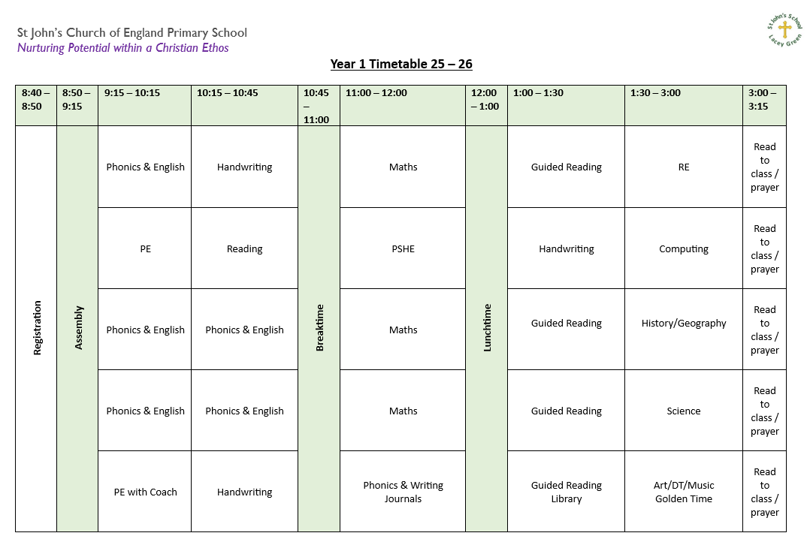

Slide 6
Topics
6 key topics covered (1 per half term):
Paddington
Toys through time
Hot and Cold places
Captain Scott
Recycling
Moon Landing
Look on the class pages for Knowledge Organisers and further information

Slide 7
Trips and Events
There will be services at the Church throughout the year, including: start and end of term services, Remembrance, Christmas and Easter.
Sport – there will be some opportunities for some children to take part in sports events throughout the year.
There will be a school trip, more information will be given when we know more details.
Notes:
PRUS sports events

Slide 8
PE
Our PE lessons will be on the following days:
Tuesday morning
Friday morning (with Coach)
Please could you ensure that your child has their PE kit in school with them all week.
Please name everything!
We promote the children’s independence as much as possible.
Children should wear a St John’s polo shirt, black or navy shorts and plimsolls or trainers for PE. In the winter they can wear black/navy joggers and their St. John’s PE Hoodie.
Notes:
We won’t be sending PE kits home every Friday in Year 1. Unless they get dirty, we will send them home at half term. Please then ensure they are back in school for the Wednesday.

Slide 9
Expectations
Respectful behaviour
Presentation of work

Slide 10
Snacks and Lunch
As you should all be aware, snacks and lunches must be nut free.
The children will have a morning and afternoon snack/break time. At morning break, the children will have their own snack. In the afternoon, the children are welcome to have a school snack. However, this is only 1 per child, per day.
Snacks can be kept in your child’s bookbag. This should be fruit/veg please.
Please provide extra fruit if your child gets hungry.

Slide 11
The importance of reading
Reading books and reading records should be in school every day.
Reading books and reading records will be handed out within the first couple of weeks in September (we will listen to all children read and then hand the books out).
Reading books will be changed most days, when necessary.
Please ensure you sign your child’s reading record every time they read at home – daily as much as possible – house points on offer.
Initially the children will be reminded that they need to hand their books in, however throughout the year, we try to encourage their independence, so they are encouraged to do this for themselves.
Notes:
Please sign even if they only read a few pages each night. They will earn a house point for each time they read at home.
Books will be changed once the whole book has been read.

Slide 12
Library
After half term, the children will start going to the library once a week.
Please make sure your child brings their library book back to school each week.
If books aren’t given back, your child won’t be able to choose another book from the library until the previous book is given back.
However, if your child hasn’t finished the book, they are welcome to keep this for another week.
If your child chooses a library book with a star on it, they will receive a house point once this is read at home and returned.

Slide 13
Phonics
Phonics continues to develop during Year One.
We will be continuing with our Little Wandle scheme of work.
Phonics will be taught daily throughout the year.
At the end of Year One there is a Phonics Screening Check, and your child will need to be able to blend all sounds introduced in Reception and Year One. More information about this will be sent out nearer the time.
Notes:
More information about the Phonics Check will be provided nearer to the time.

Slide 14
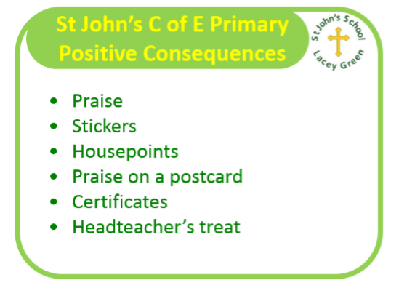
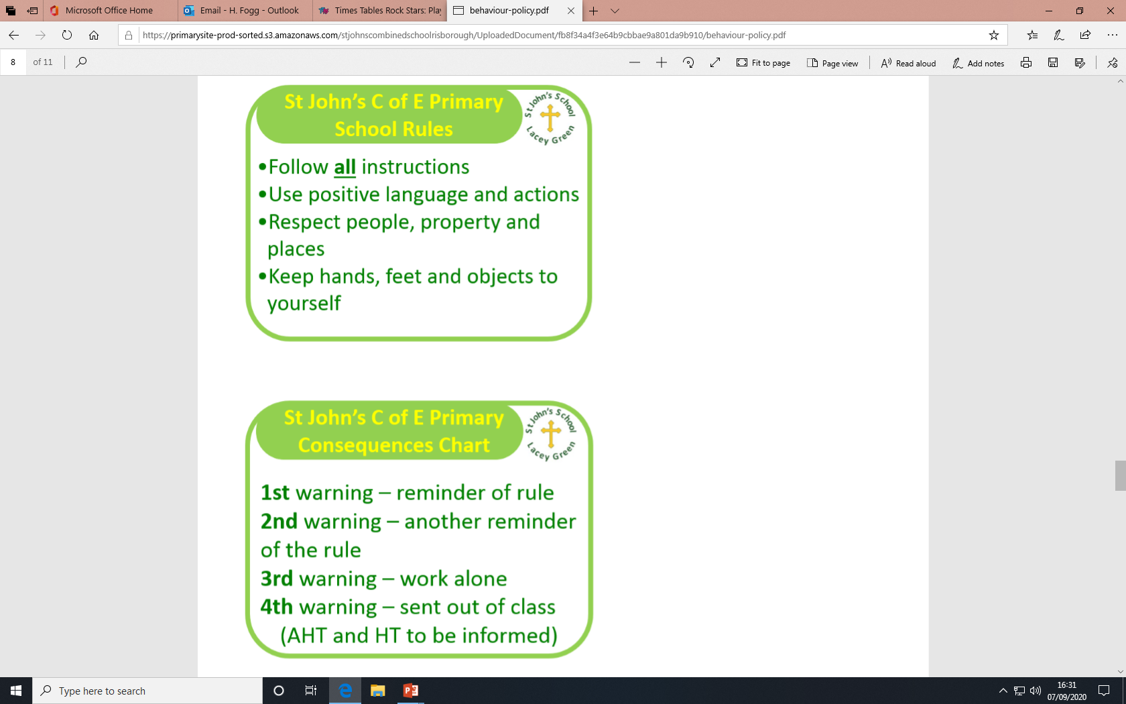
Rules, Rewards & Consequences
At St John’s we have high expectations for behaviour.
We aim to notice and praise thoughtful and kind behaviour, we reward effort and we model and encourage good manners. We use verbal praise, stickers and house points.
We recognise that children in Year One are young and some are still learning self-control and appropriate ways to behave. However, most children know what is/is not acceptable.
If a child behaves inappropriately despite being shown how to behave, they will be given a warning which may lead to time out. Parents will be informed if necessary.

Slide 15
Homework
READING – READING - READING
Phonics
Number bonds

Slide 16

New this year – St. John’s passport
This is an A5 booklet with a cardboard front cover. Similar in size and style to the KS2 reading record books. These are going to be kept in School.

Slide 17
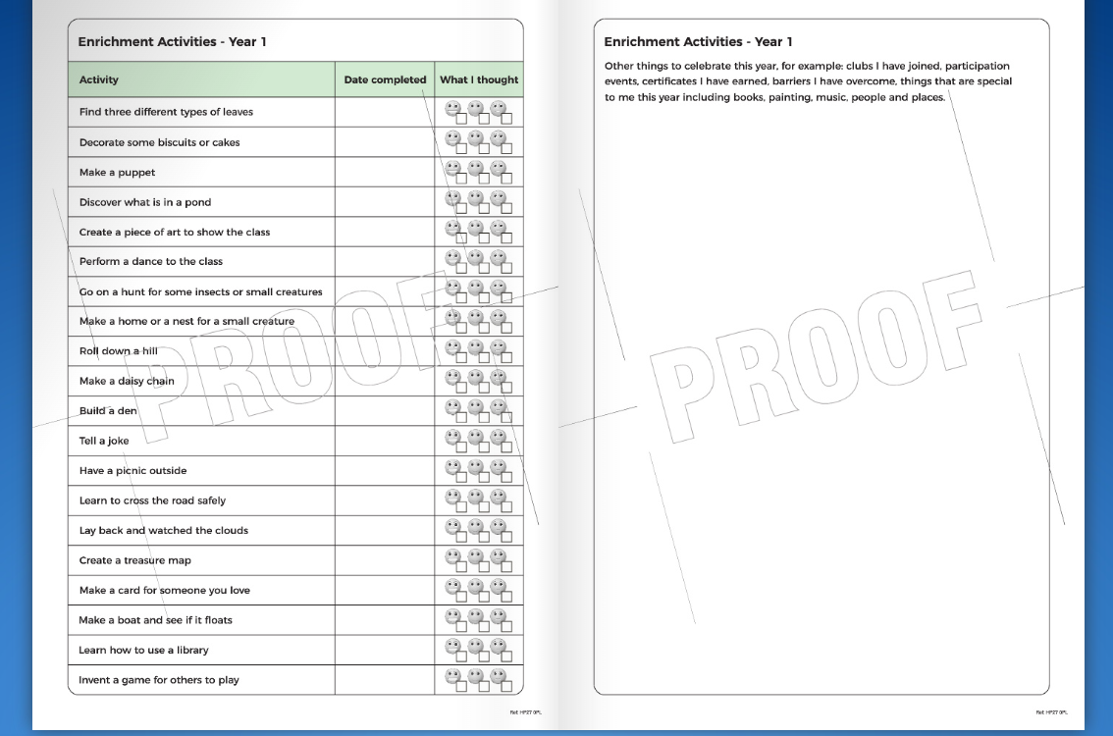

Slide 18
Pick up and drop off information
Main gates open from 8:30am
Children are welcome into the classrooms from 8:40am
Register closes at 8:55am
Gates to parents open at 3:00pm
Pupils led out at 3:15pm
The children will all come outside and wait by the wall. Once all children are outside, we will send them to their Parents/Carers.

Slide 19
Pick up information
If your child is going home with someone else, please make sure you let us know. E.g. if they are going to a friends house, Grandparents will be collecting and they don’t usually.
The easiest way to do this is to let Mrs Cassap know in the morning and she will then let me know.
Thank you in advance, it just makes things easier at home time.
Notes:
This is 5 minutes earlier than usual, a letter will go out about this.

Slide 20
Contact Information
If you need to contact us, please email the Office – office@jlg.odbst.org who will forward the email to class teachers where necessary, or alternatively reply back with an answer if they can.
Please be aware that we do not reply to emails during the day as we are teaching.
Friday News has all the information about what we have been learning during the week.
If it is urgent phone the Office on 01844 343521

Slide 21
Finally
Please could we request some boxes of tissues for the class – thank you.
Any worries, concerns or questions, please let us know – email the Office, or ask at pick up or drop off.
Are there any questions?
Thank you all for coming.
This presentation will be sent out and put on the Year 1 Class Page if you need to see any information again.

