Slide 1


Meet the Teacher
Year 4
Class teacher: Mrs Moss
Tuesday 8st July 2025

Slide 2

Vision and Values
As a Church school we have a distinctive character where Christian values are promoted in all aspects of school life.
Nurturing potential for all within a Christian ethos
Together we will work to enable all our children to achieve their full potential within our Christian family. Through the teachings and examples of Jesus, we nurture individuality - providing challenge, developing self-esteem and promoting care and respect for each other and God’s world.
‘I can do all things through Christ who strengthens me’ Philippians 4:13

Slide 3
Timetabling
PE days: Monday pm and Friday pm
PE kit in school every day please. The children will come home wearing their PE kit on Friday.
Kit should include the following: trainers, jogging bottoms/leggings, t-shirt, socks, shorts and a fleece/hoody.

Slide 4
Topics
Autumn: Europe and the Stone Age
Spring: Biomes and the Roman Empire
(Hope for a trip to Verulamium Museum in St Albans)
Summer: Japan and Monarchs Through Time

Slide 5
Equipment List
Pencil case including:
Pencil
Colouring pencils
Sharpener (not a toy)
Ruler
Eraser
Whiteboard pens
Glue stick
Handwriting pen (when pen licence has been issued)
Please make sure these are regularly checked, especially whiteboard pens)

Slide 6
The importance of reading
Reading with your child—whether you're reading to them or listening as they read—nurtures imagination, enriches language development, and deepens emotional bonds; no child is ever too old to benefit from this shared experience.
To encourage your child to read:
Children are awarded house points for every signed entry in their reading diary.
It must be signed by parents and not by the children.
If possible, please listen to your child read each evening – even if just a few pages. Discuss the book with and talk about what might happen next.
Children should read a variety of age-appropriate texts including fiction and non-fiction. In September, there will be a list of books suggestions on the school website.
They can borrow books from the school library. Some children will also be given a book from the school scheme.

Slide 7
Rules, Rewards & Consequences
School Rules
Follow all instructions from all adults.
Use positive language and actions
Look after people, property and places
Respect each others space and keep hands, feet and objects to yourself

Slide 8
Rules, Rewards & Consequences
Rewards
House points
Whole class merits
Stickers
Headteacher rewards
Golden Housepoint

Slide 9
Homework
Daily reading preferably to an adult.
Weekly spellings which will be issued on a Monday and tested the following Monday.
Times tables (which are tested in class every Friday.)

Slide 10

New this year –St. John’s passport
This is an A5 booklet similar in size and style to the KS2 reading record books.

Slide 11
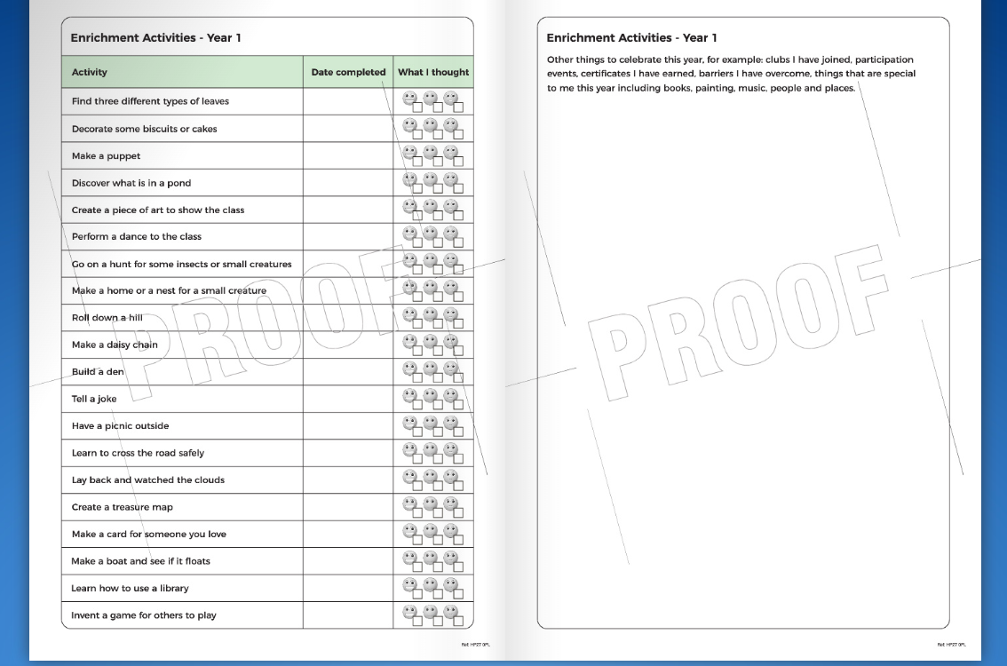

Slide 12
Pick up and drop off information
Main gates open from 8:30am
Children are welcomed into the classrooms from 8:40am
Register closes at 8:55am
Gates to parents open at 3:00pm
Pupils led out at 3:15pm

Slide 13
Parent Help
We would very much welcome any support or time you or other relatives such as grandparents could give us.
Support with reading
Library
Computing
Art
Please let us know if you think you can help and your availability either by email or after the meeting.

Slide 14
Contact information
You can email the school office who will forward messages to class teachers: office@jlg.odbst.org
Please be aware that we are unlikely to reply during the school day as we will be teaching.
Friday News on the school website has all the information about what we have been learning during the week.
If something is urgent, please phone the school office on: 01844 343521

Slide 15


