Slide 1
Internet Safety
Parent information Session
Tuesday 6th February
Notes:
Welcome
Safer internet day is marked every year in school. It brings to the forefront the importance of staying safe when online
Whole school assembly today talking about changes that can occur when using devices and what to do
In school we want to ensure children know the fundamentals of staying safe online, how they should be using computers and the internet safely and responsibly and know what to do if they don’t feel safe when online.
Each computing lesson classes will discuss something related to e safety before or during their lesson e.g they may discuss a scenario

Slide 2
In this session
Mobile devices and young people
Establishing ground rules
Places to seek guidance
Parent views and perspectives

Slide 3
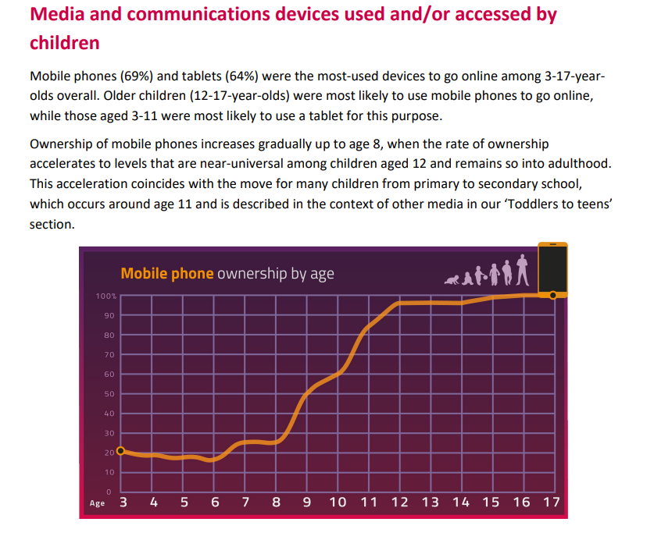
Background…
Notes:
https://www.ofcom.org.uk/__data/assets/pdf_file/0027/255852/childrens-media-use-and-attitudes-report-2023.pdf
For many young people a mobile device is slowly becoming the norm, and is paramount that parents understand how mobile devices should be used and how to manage using the device

Slide 4
What do your children use the internet for?

Slide 5
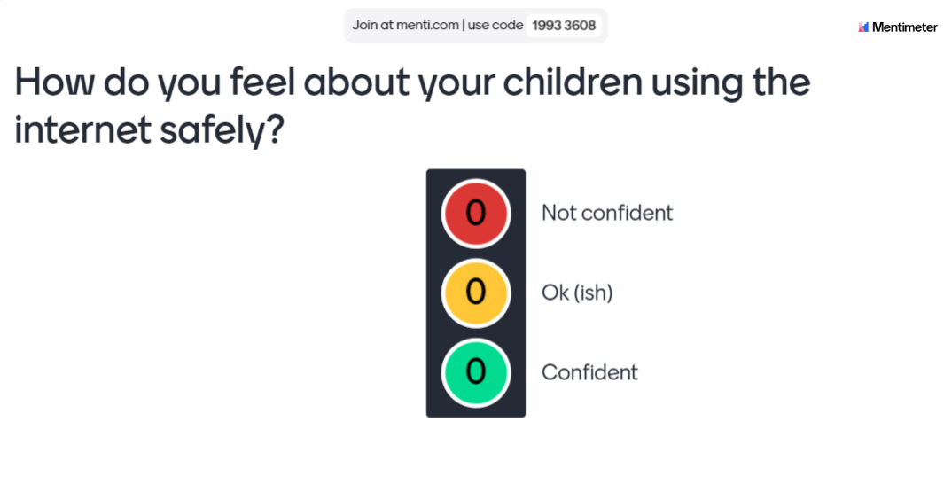
Notes:
Let’s gauge some peoples level of confidence with regard to children using internet safely. What is it you feel you need the most support with?

Slide 6

The Children’s Wellbeing in a Digital World: Index Report 2024
The wellbeing research focuses on both the positive and negative impacts of the online world on children and young people.
The 2024 report highlights increasing concerns from parents about the time their child spends on devices and the effects on family life, health and concentration
Our survey shows an increasing use of tech devices that coincides with growing concerns about screen time interfering with family time.
Notes:
https://www.internetmatters.org/hub/research/childrens-wellbeing-in-a-digital-world-index-report-2024/#full-report
So many positives for children using the internet, however more people concerned with screen time etc, which is why it is so important to set clear ground rules with a device and have open conversations about what the device is being used for

Slide 7
Exploring devices and purposes

Slide 8
Risks
Benefits
Cyberbullying and harassment from friends and strangers
Unwanted or inappropriate contact from friends and strangers
Over-sharing personal information, such as full name, location or images
Accessing inappropriate content
Spending too much money
Excessive screen time
Behaving inappropriately or unkindly online
Phones can send and receive calls and messages
browse the internet and take photos and videos.
Apps for:
watching videos,
connecting with friends,
making video calls,
playing games
news updates
supporting learning
Notes:
Risks: Many of the risks depend on how a device is being used. There are some key concerns people have about children using phones in particular:
Positives: Phones give young people a way to keep in touch with their friends and families, look up information and enjoy games and social media.

Slide 9
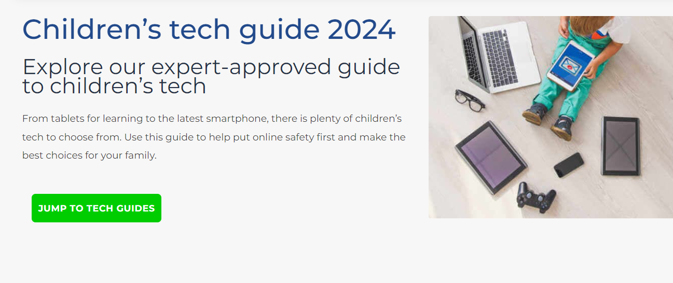
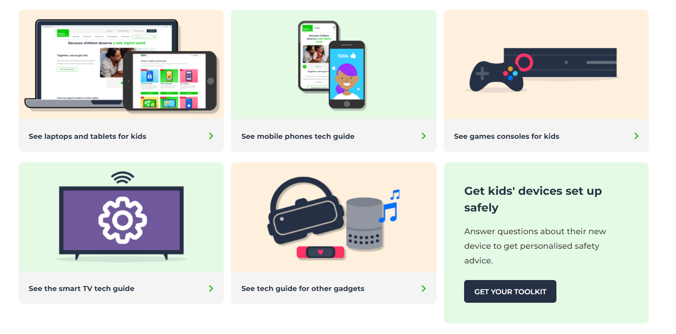
How can we keep our children safe online…
Notes:
Internet matters has got a great guide on up-to-date technology and how to set up parental controls. They work in partnership with other tech firms such as EE, NOW tv, Sky, Samsung, Sony, Roblox

Slide 10
Creating Ground Rules

Slide 11
What ground rules do you have in place?
How much screen time?
When does the device get switched off?
Where in the home can your child play on the device?
Open conversations about what they have viewed
What Apps are allowed?
Do you check what is being viewed?
Do some of the rules apply to the whole household?
Do they know what to do if they see something they don’t like?

Slide 12
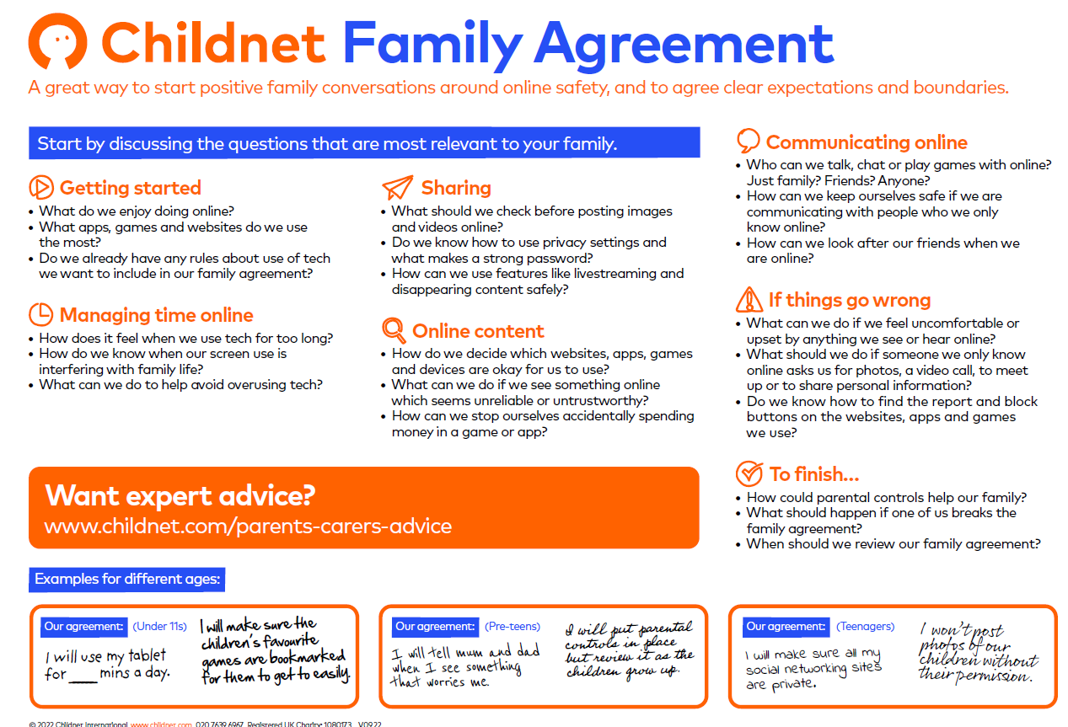
Creating ground rules…
Notes:
Really important to set ground rules/ family rules for children being given the responsibility of mobiles.

Slide 13
Conversations with children are so important
“Technological supports, like privacy software, can be useful and there are many good resources online about child-friendly tech tools. These tools, though, are not a replacement for the ongoing conversations that grown-ups need to have with kids about what they are seeing, hearing, and believing based on information they encounter via apps and games.” Nick Leftly – Technology expert TIME magazine
Why do you want to get a phone?
What do you like about using your phone?
What would you do if something worrying or upsetting happened on your phone?
How can we do more online together?
Notes:
Why do you want to get a phone?
Whilst deciding if it is time for your child to have their first phone can be a great opportunity to find out what your child expects to use their phone for. This could be for connecting with friends, playing games, for keeping in touch whilst out of the house or other reasons.
What do you like about using your phone?
You can ask your child about their favourite apps or games, what they like using their phone for, or you can ask them to show you how to play or use their favourite game or website.
What would you do if something worrying or upsetting happened on your phone?
You can ask them about the places they can go to find the safety advice, find out what they know about privacy settings, and ask them how to report or block on the services they use.
How can we do more online together?
Ask your child about activities or games that you could enjoy as a family, this can be a great time to establish a family agreement to manage your families time online.

Slide 14
Setting up devices…
Parental controls
Emergency contacts saved (including the school)
Web trackers
Location trackers
Notes:
Parental controls –
https://www.internetmatters.org/parental-controls/smartphones-and-other-devices/
password protect app downloads on smartphones – You won’t want children being able to download apps freely without your eyes on what it is. Whether its got in app purchases. Also for the memory of the phone. It will also allow for conversations before an app is downloaded.
Web trackers - “Apps like Google Family Link, FamilyTime, Qustodio, ESET Parental Control, WebWatcher, and more are all great options to monitor what your kid is up to on the phone,” adds Dana Oliver, president and founder of Adventure Kids Playcare.
Locational trackers - “Life 360 is one of the apps that many college students use to keep track of each other and their friends. Coming up with a family ‘circle’ where everyone can see each other is a great way to practice honesty, transparency, and safety. Emphasizing that it’s not your child whom you don’t trust, but other strangers in the world, will prevent your teenager from feeling belittled or infantilized, and will make them more willing to share their locations with you.”
“Find My iPhone and Life 360 are my go to,” says Reena B. Patel, parenting expert and licensed Educational Board certified behavior analyst. “Yes, even for older children. Make it a family rule that every member, even parents, can be tracked for safety purposes. Do discuss this rule with the family and how safety plays a role. Parents of young adults can know where their child is, but should allow for autonomy and not question where they are. This will help maintain your ability to track.”

Slide 15
TOP TIPS
Talk with your child about responsible use of their phone/device
Discuss what to do if something upsetting or worrying happens
Explore parental controls
Discuss about privacy of their phone
Notes:
There are so many areas of online safety that can be discussed. The most important thing we can do as parents is establish, open and honest conversations about devices and the internet.
Talk with your child about responsible use of their device
Discuss what is okay and not okay to use their device for. Talk about time limits and expectations of where the device can and cannot be used, this could include things like the phone being charged outside their bedroom overnight.
Discuss what to do if something upsetting or worrying happens
Give them the strategies they need in case something concerning happens whilst they are using their device. This could be to lock the screen and tell an adult, to make a report to the platform they are using, or to block the user.
Explore parental controls
Take a look at the controls available both on the phone itself and on your home Wi-Fi. Talk these through with your child too. Parental controls are a helpful tool, but an open conversation with your child is the most important thing.
Discuss about privacy of their phone A phone number is a very personal thing. Once its given out there is no control over it any more. A conversation about how freely this is handed out and to who it really important.

Slide 16
Useful links for parents
https://saferinternet.org.uk/guide-and-resource/parents-and-carers/phones
https://time.com/shopping/article/best-phones-for-kids/#the-best-phones-for-kids-thatll-give-parents-peace-of-mind-top
https://www.internetmatters.org/parental-controls/smartphones-and-other-devices/
https://www.internetmatters.org/resources/tech-guide/
https://www.internetmatters.org/resources/guide-to-hand-me-down-devices/#safety-used-devices
https://www.childnet.com/resources/moving-on-up/
https://www.internetmatters.org/hub/research/childrens-wellbeing-in-a-digital-world-index-report-2024/#full-report
https://www.nspcc.org.uk/keeping-children-safe/online-safety/online-safety-blog/2023-01-12-is-whatsapp-safe-for-my-child/
Notes:
Thank you.
Links to many useful guides/advice etc.
We as a school are here to support so do please reach out if you feel you are struggling with something relating to online safety.

